Slide 1
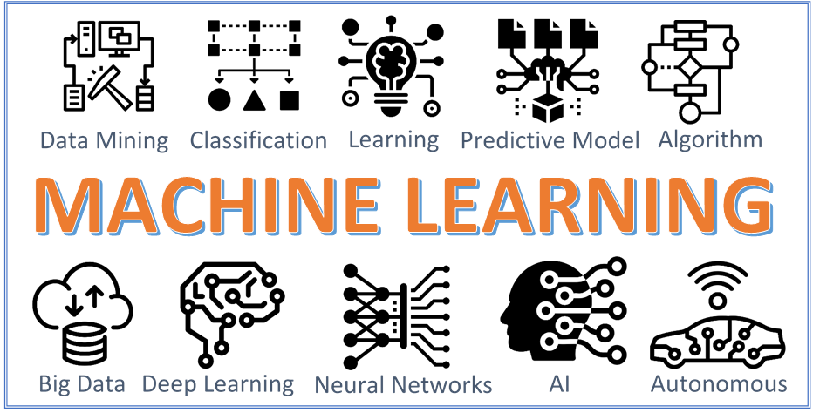
Department of Electrical and Computer Engineering
EEL 5840 Fundamentals of Machine Learning, Fall 2022
Slack: uf-eel5840-fall2022.slack.com
GitHub Org: https://github.com/UF-EEL5840-F22

Slide 2
EEL 5840 – Fundamentals of Machine Learning
Course Objectives:
Understand and utilize the concepts of machine learning for data science and electrical engineering. Focus on tools for multivariate data analysis and how to handle uncertain data with probability models.
Upon completion of this course, the student will be able to:
Identify relevant real-world problems as instances of canonical machine learning problems.
Design and implement effective strategies for data preprocessing.
Explain and utilize concepts of machine learning for data science and electrical engineering
Compare and contrast evaluation metrics
This course relies mostly on foundational machine learning math but also programming!
We will use Python for in-class examples, class assignments and the final project.

Slide 3
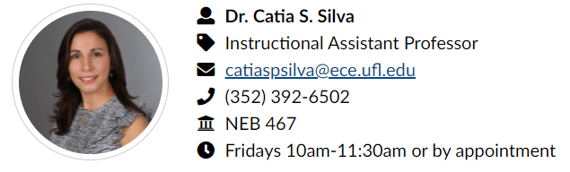
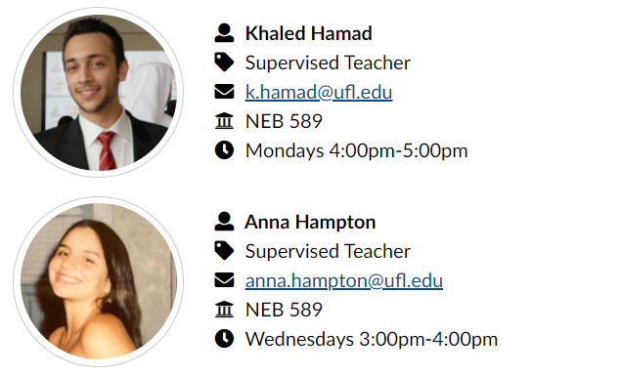
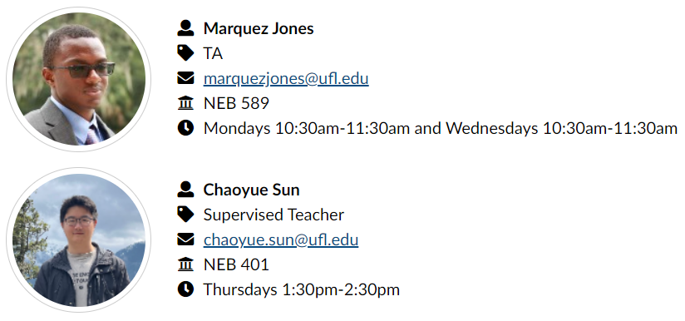
Teaching Team

Slide 4
Dr. Catia S. Silva (she/her)
Phonetic spelling: KA-tee-uh SIL-vuh
Instructional Assistant Professor @ ECE, UF
PhD in Electrical and Computer Engineering @ UF 2018
Preferred contact: email or slack
Research interests: multi-disciplinary machine learning, learning theory, computer vision, pattern recognition, computational neuroscience
Past student-led projects: https://catiaspsilva.github.io/projects/
Industry experience: large institution (INESC TEC, Portugal) and small startup company (Aventusoft, Boca Raton, FL)
More about me…
Born and raised in Portugal
I speak a few languages: Portuguese, English, French, Spanish and limited Italian
I have a 7-year-old dog named Maggie
I enjoy running, hiking with Maggie and family, brain games, cooking and try new cuisines, listening to music and podcasts, reading

Slide 5
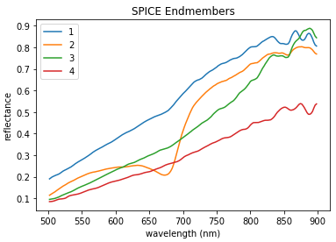
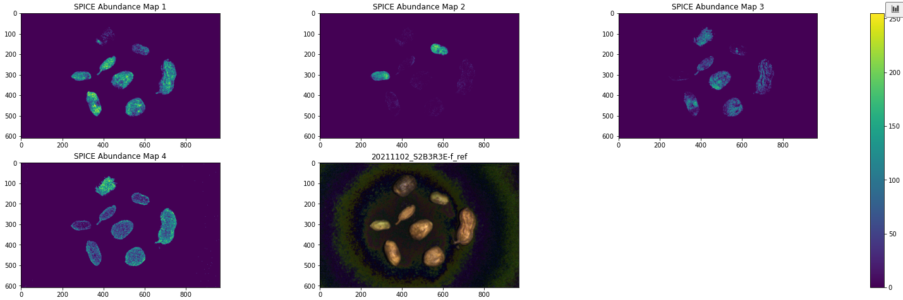
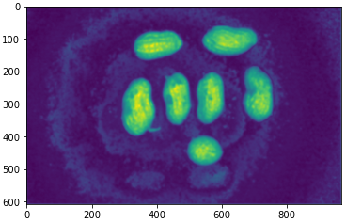
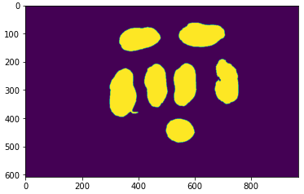


Khaled Hamad
PhD Student in the Machine Learning and Sensing Lab
Research focus: Detecting and predicting Aflatoxin on peanuts with Machine Learning algorithms by analyzing Hyperspectral data.
Hobbies: Gym, cooking, video games (Not much recently).
Segmentation

Slide 6

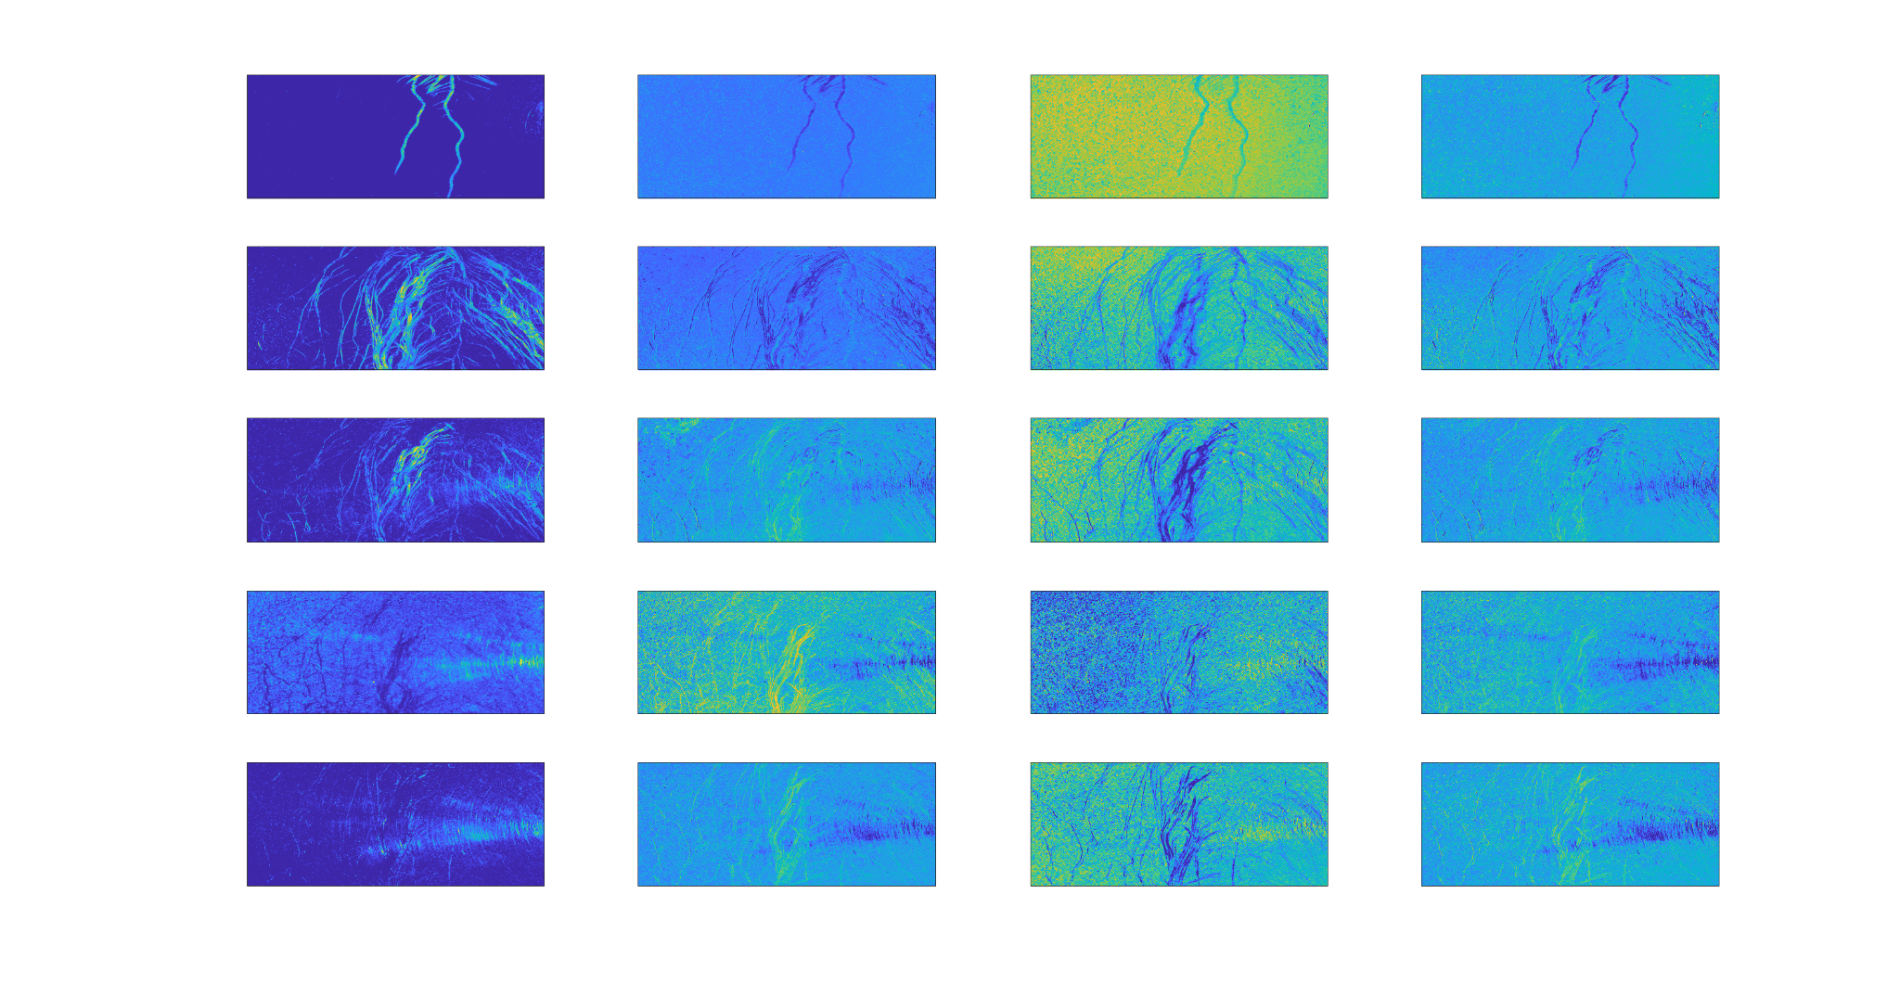
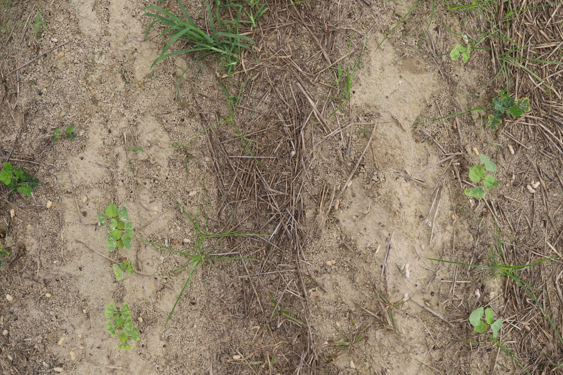
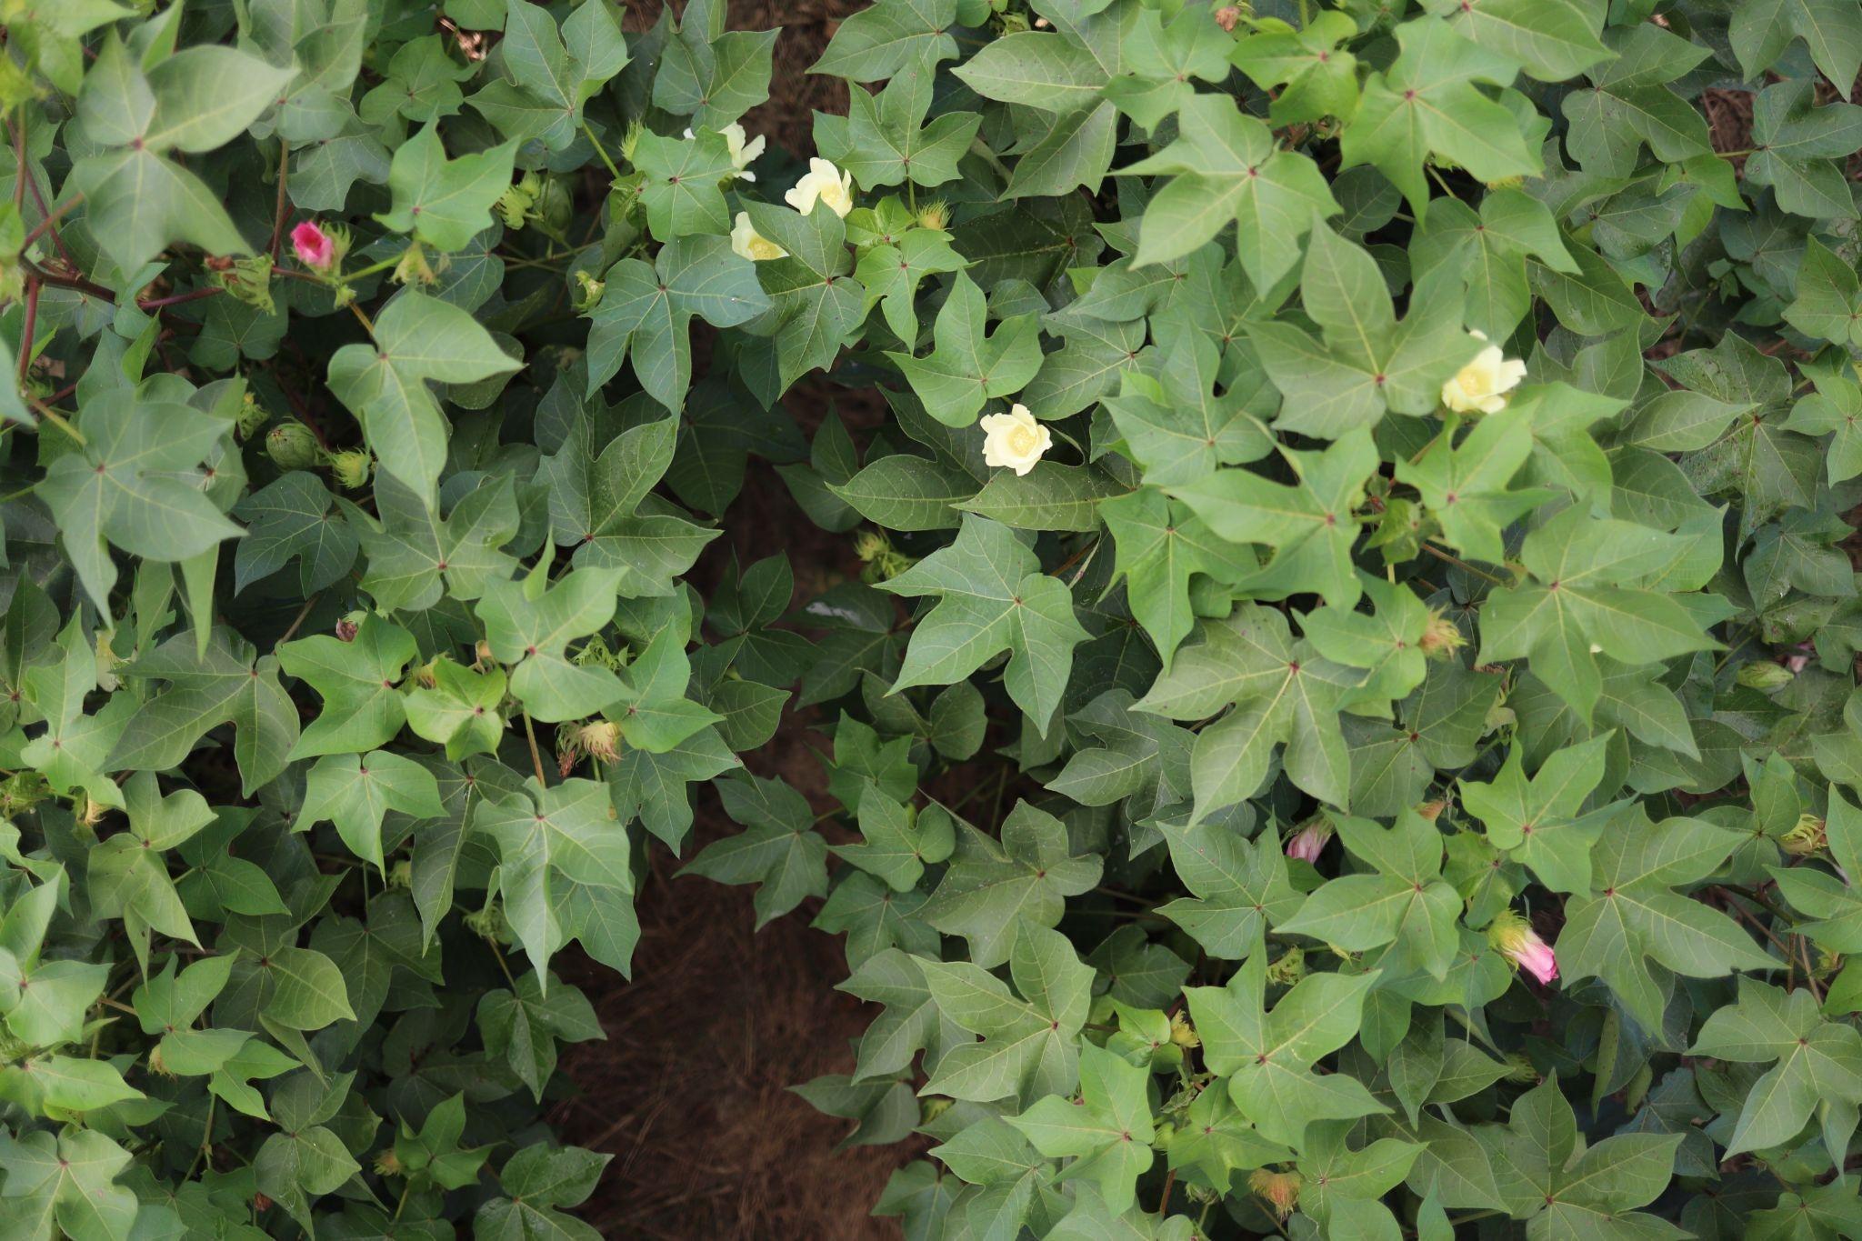
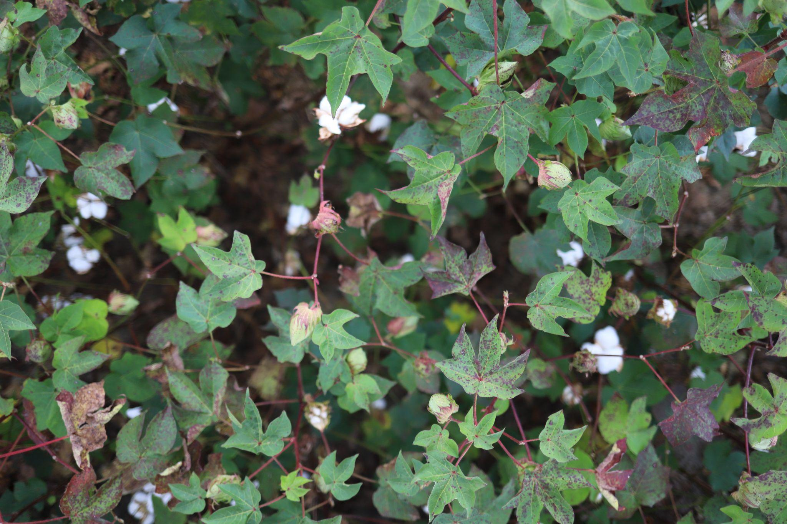
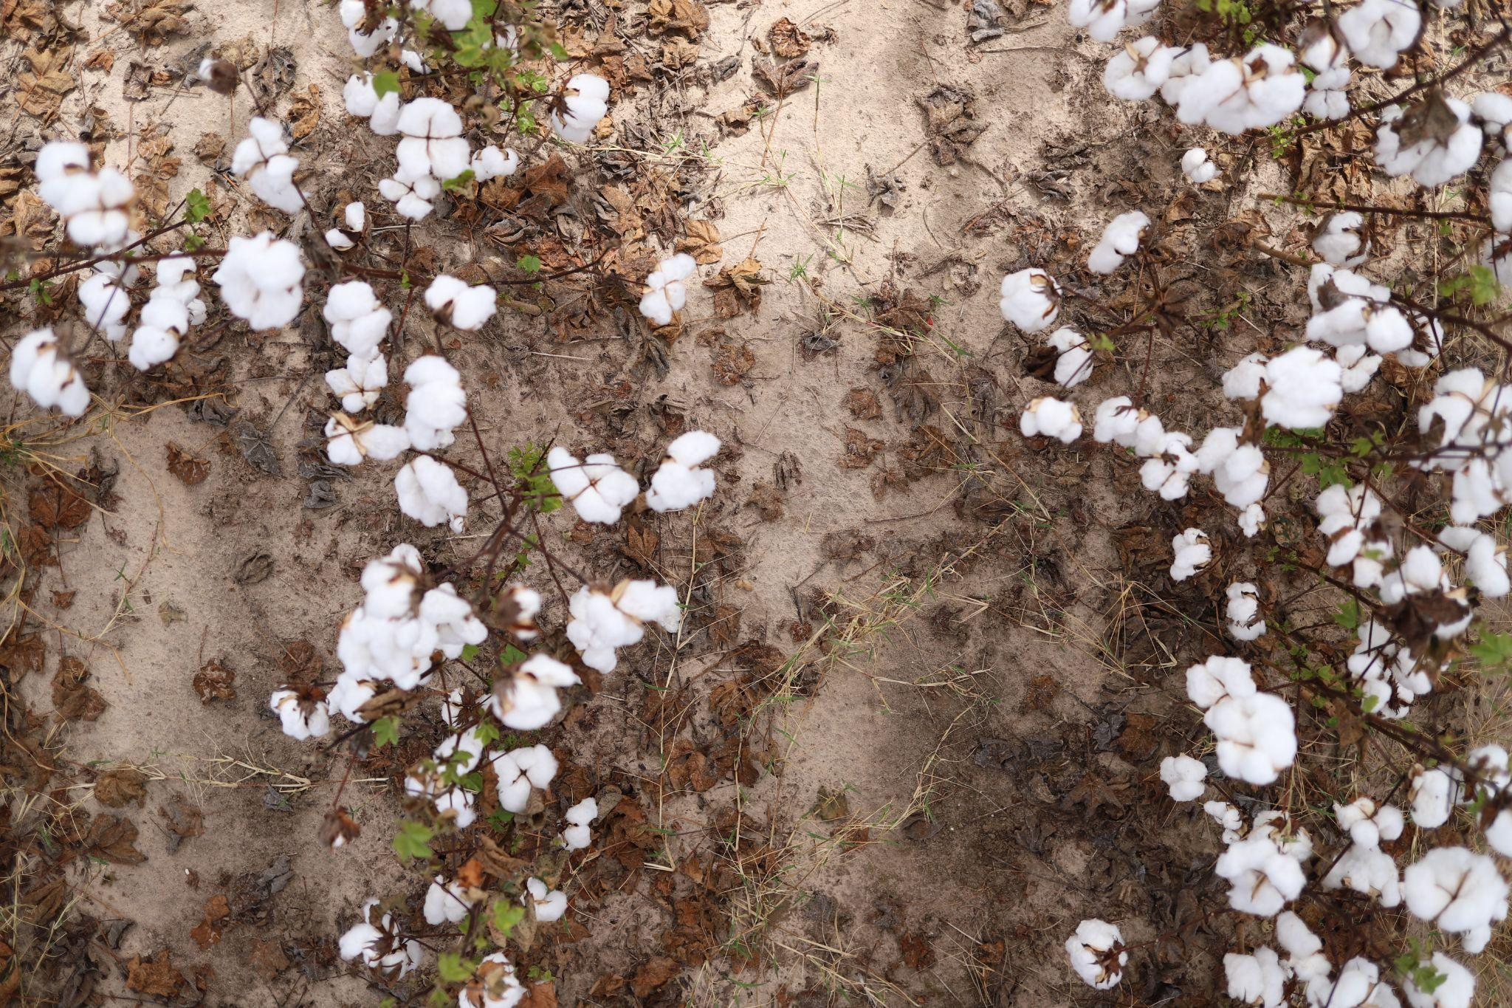
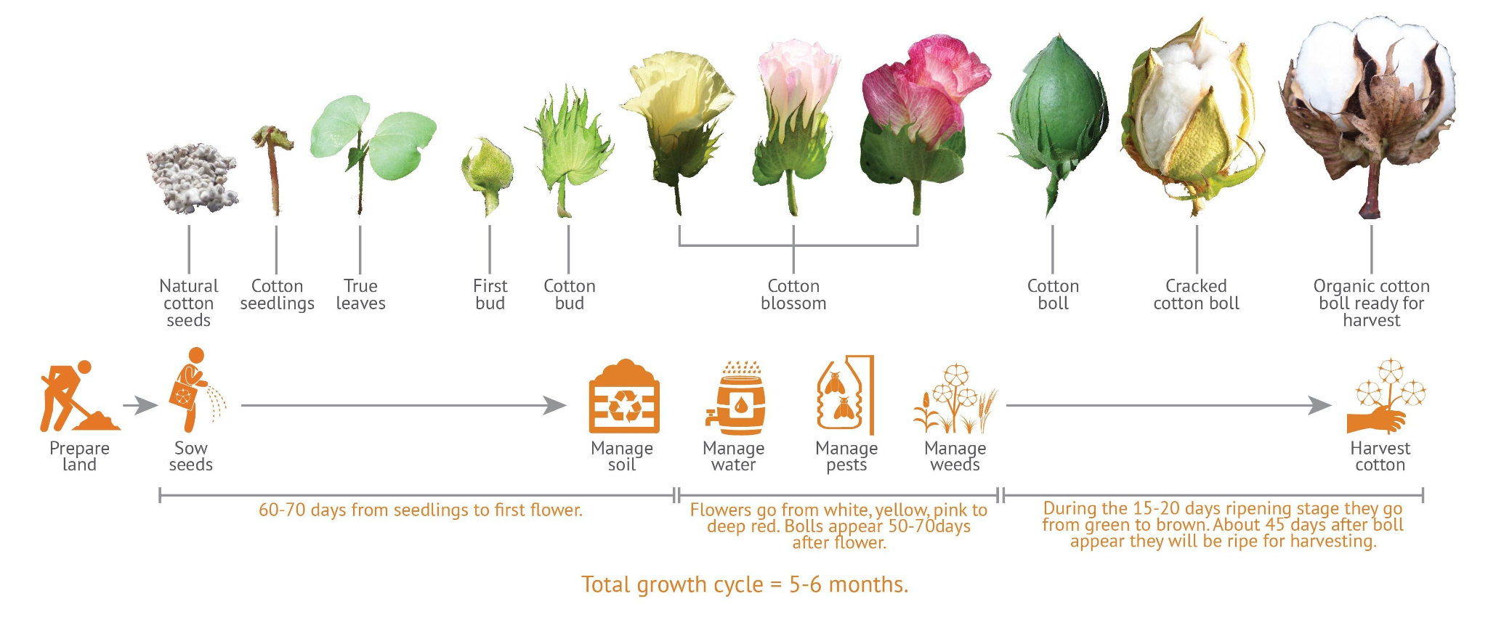
Anna Hampton
PhD student in the Machine Learning and Sensing Lab
My research focuses on applying machine learning and hyperspectral analysis techniques to agricultural and plant science problems.
I love math and plants.
Signature for live root
Signature for drought
Cotton growth stage detection
Live root and drought detection

Slide 7

Marquez Jones
MAHR-kez or MAHR-kwez
Office Hours
Monday/Wednesday 11:30AM to 12:30PM
Preferred Contact
Slack or Email
marquezjones@ufl.edu
Interests
Embedded Systems, IoT, Edge AI
Favorite Programming Language
C Language
Industry Experience
3x Intern at Qualcomm

Slide 8
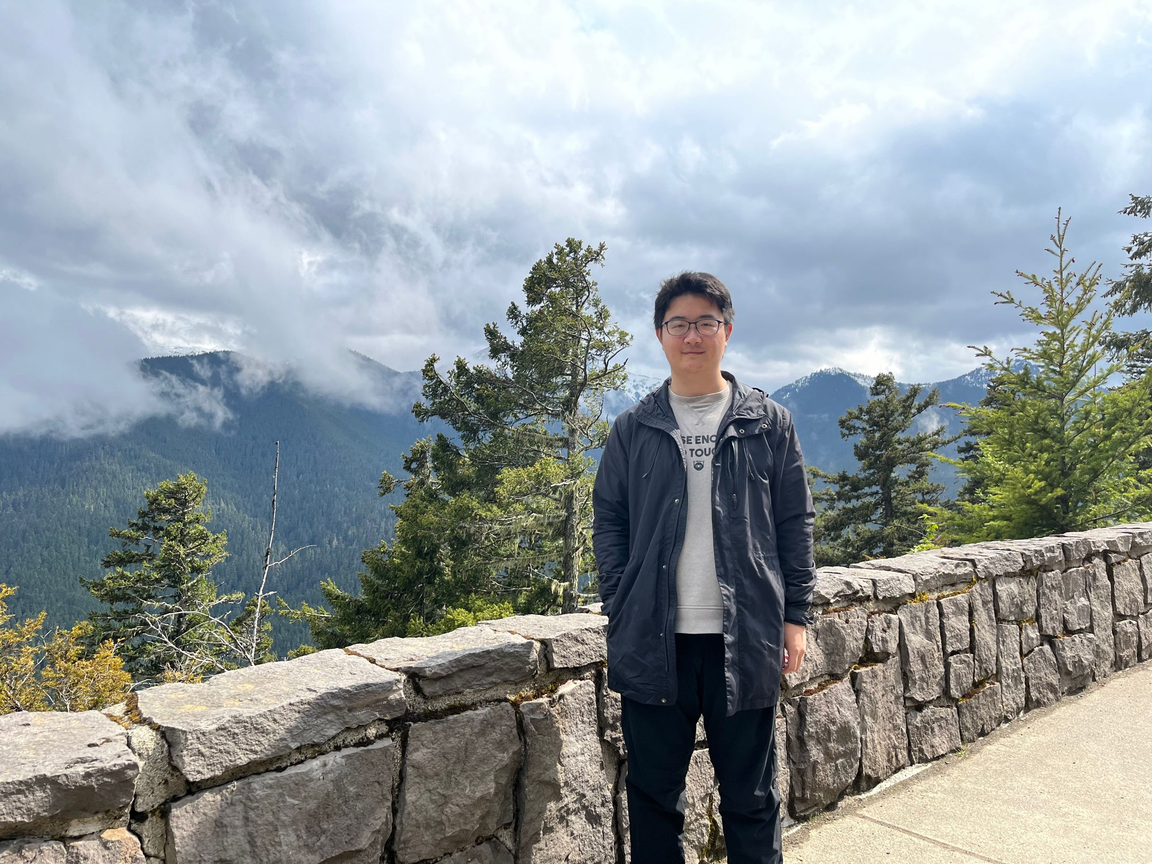
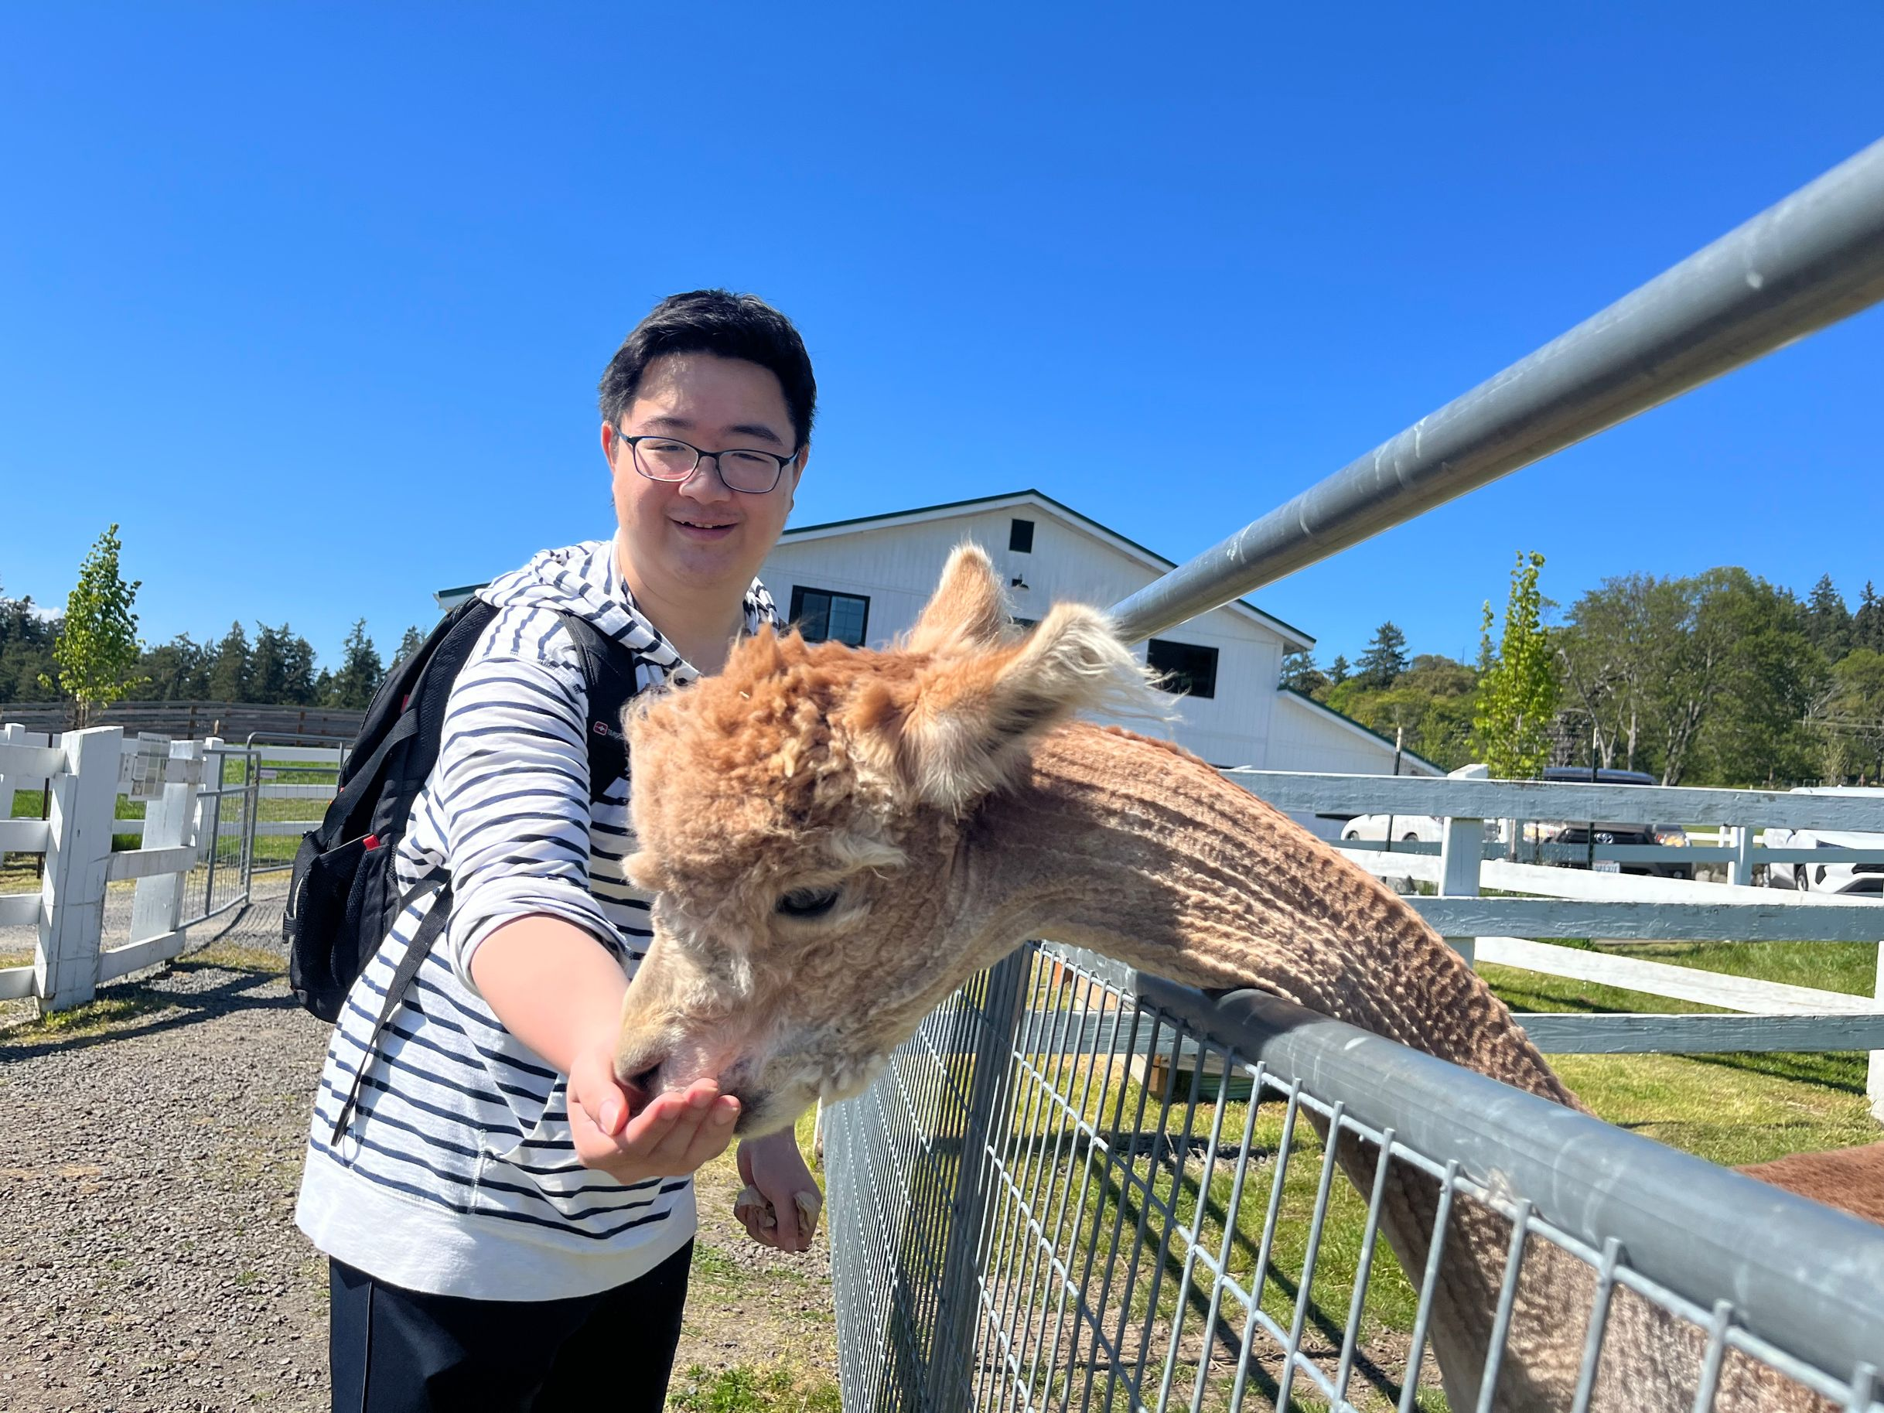
Chaoyue Sun
Phonetic pronunciation: Chow-yoo-weh Soon
Preferred way to contact: email and slack
Office hours: 1:30pm - 2:30pm every Thursday
Research:
Graph neural network models
Corresponding applications in prediction growth of epidemic disease transmission
Interest: Travelling, drums, badminton​

Slide 9
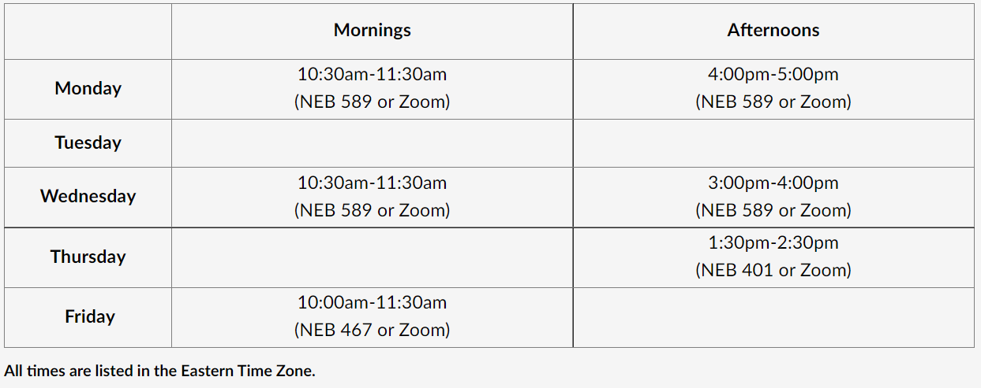

Office Hours
All office hours are hybrid: in-person and Zoom components
For EDGE/online students, Marquez is offering office hours outside those listed in this table.
Scan the QR code to book a time to meet online
Marquez calendar

Slide 10
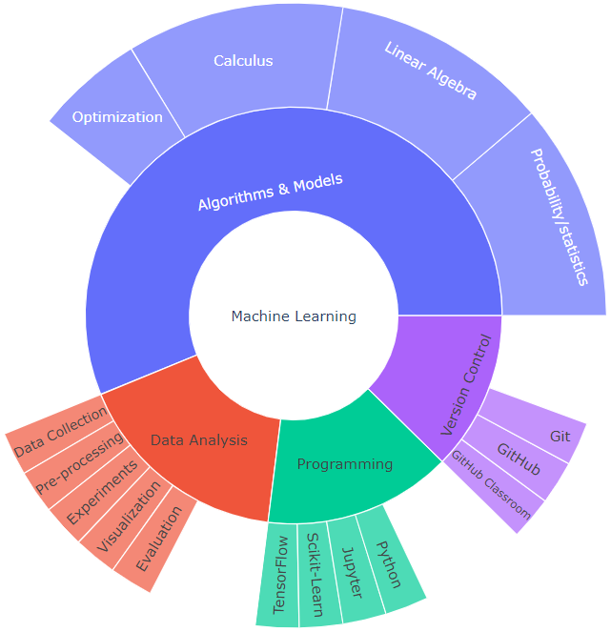
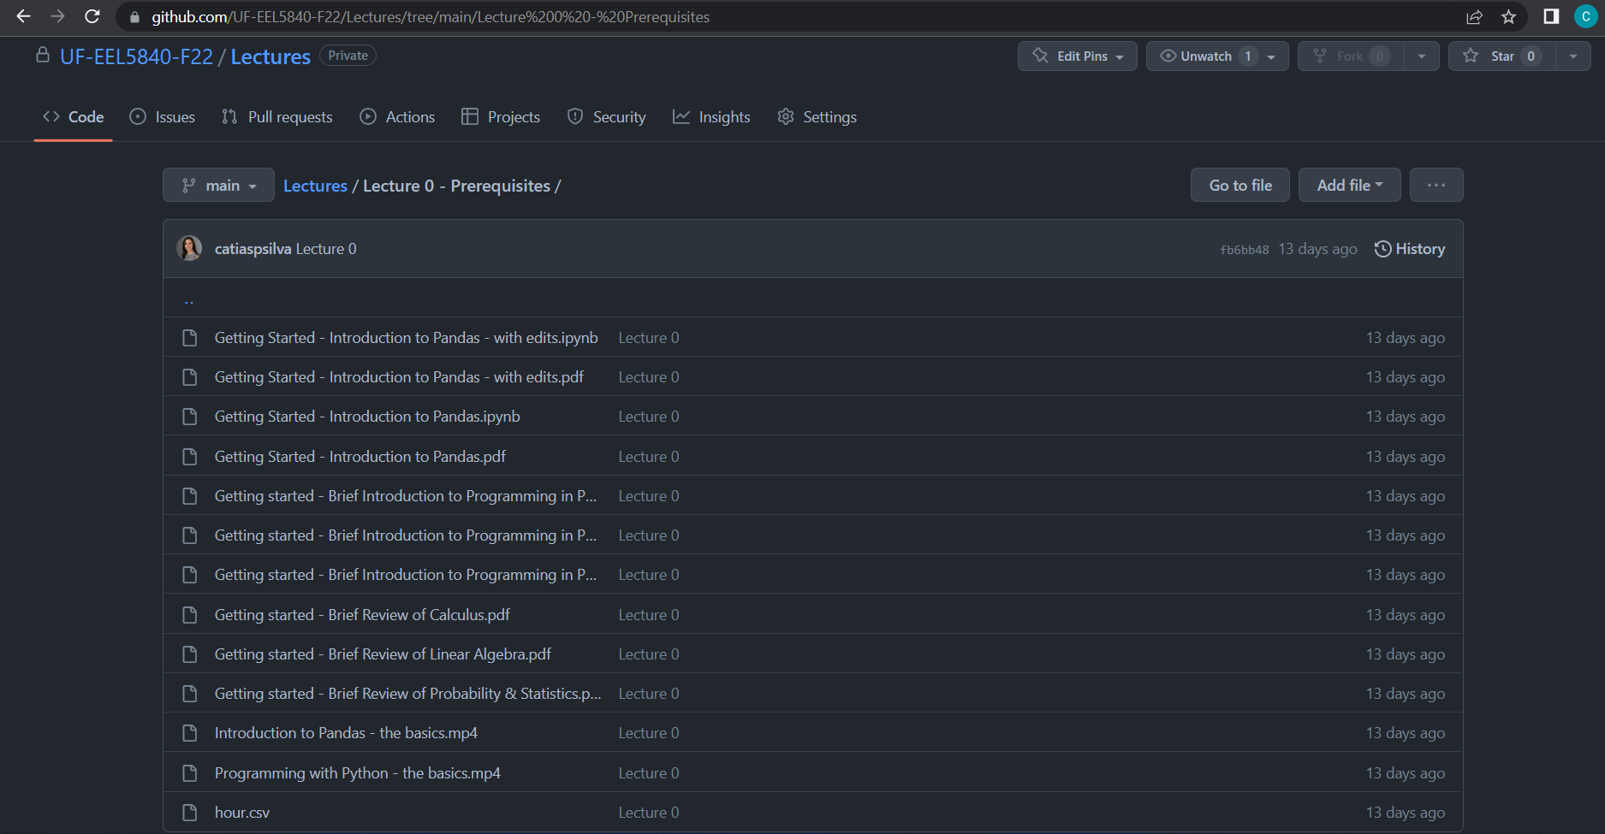
What tools will we use to teach Machine Learning?
Expected prerequisites:
Probability theory
Statistics
Linear algebra
Programming (Python preferred but not required)

Slide 11
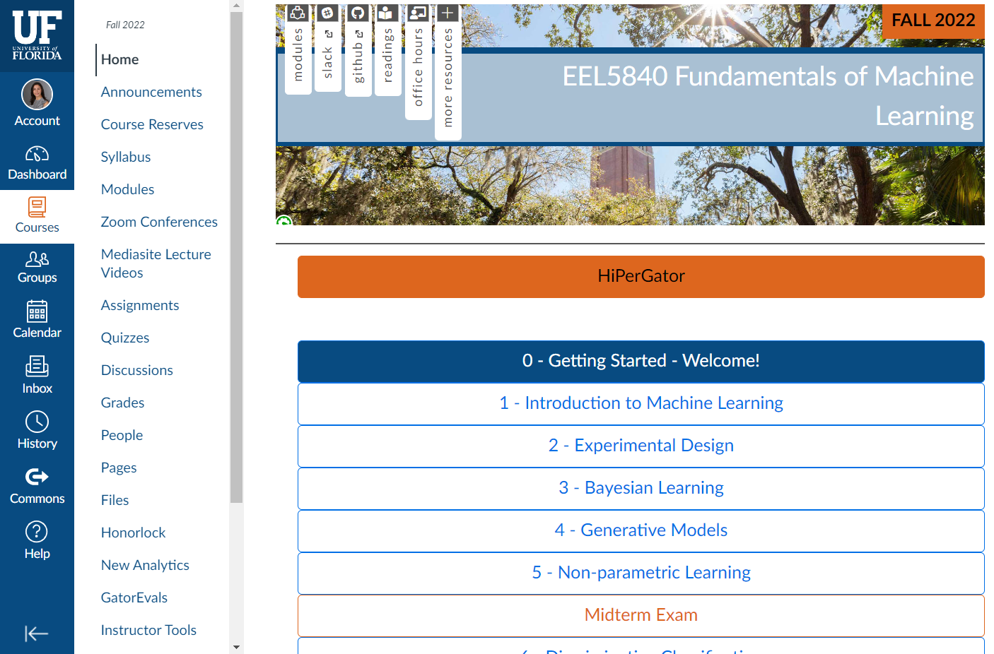
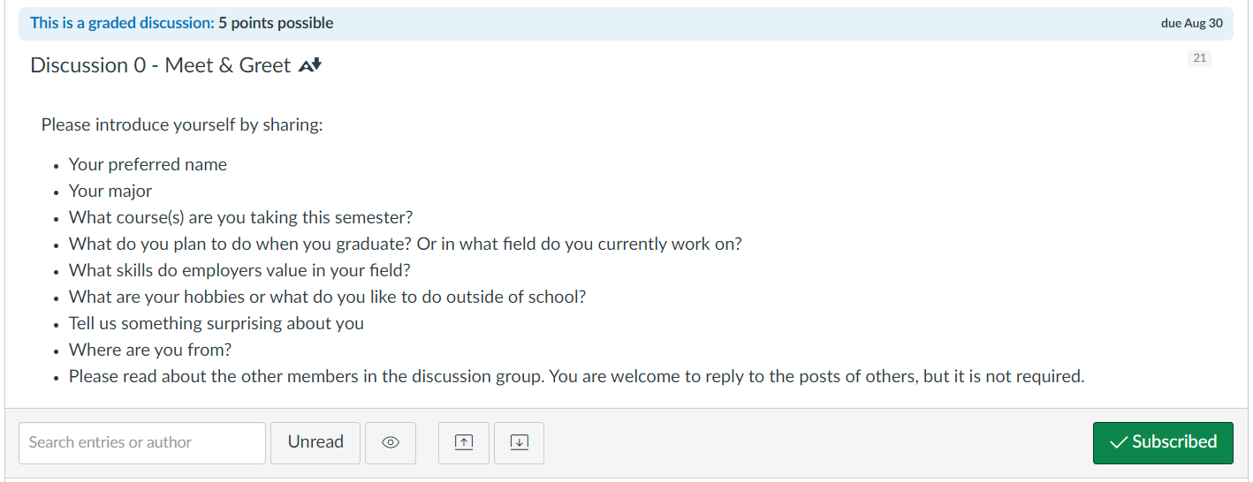
Canvas
In Canvas, we will post:
Announcements
Send/receive emails
Participation assignments through discussion boards

Slide 12
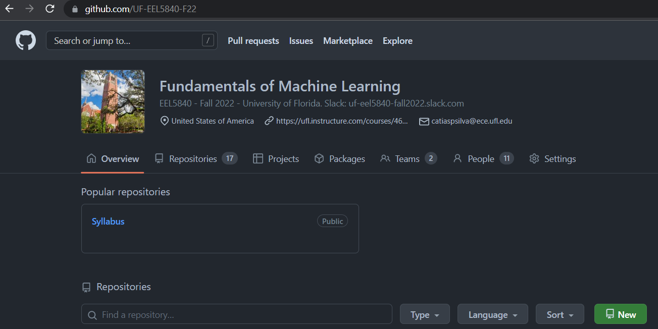
GitHub
https://github.com/UF-EEL5840-F22
In GitHub, we will post:
Lecture notes
Assignment solutions
Individual assignment repositories
Final project group repositories
All repositories should be kept private.

Slide 13
Slack
https://uf-eel5840-fall2022.slack.com
This an optional resource for students to discuss the course amongst each other and with the teaching team.
This resource is intended to supplement office hours and student interactions.
No official communication/submission happens over Slack.
No assignment submissions will be accepted over Slack.

Slide 14
Time Commitment
Work | Hours/Week
Attend lectures, ask questions | 2.5
Study/Read ~20 pages of lecture notes and code | 3
Reading assignments | 1
Homework exercises | 3
Total | 9.5

Slide 15









How does a typical lecture look like?
A typical lecture will be presented in Jupyter Notebook accompanied by digital board illustrations. Some lectures will include either live coding or running code examples from lecture notes.
We will publish the class notes (Jupyter notebooks) before every lecture
We will share the notebook with edits after class
We will share the handwritten board pages after class as well

Slide 16
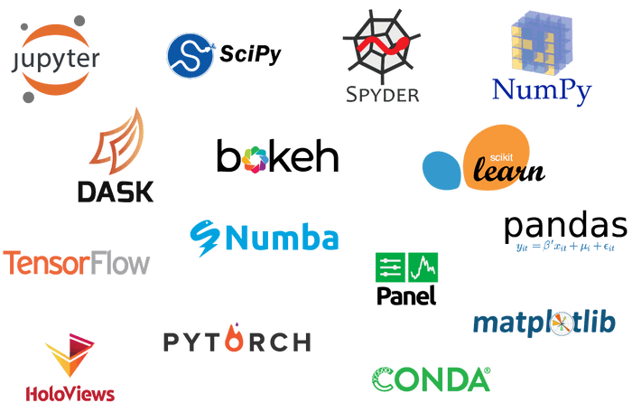
Software
Anaconda Distribution
Includes Python 3.9
It includes all libraries, modules and tools we will use: Jupyter Notebooks, NumPy, Matplotlib, SciPy, Pandas, Scikit-Learn, TensorFlow
Install it (or update it) before next lecture

Slide 17
Package Managers: conda & pip
You have 2 options to manage your packages and virtual environment/s:
using pip. System that manages Python packages.
using conda. System that manages packages that may be written in any programming language.
Since we will use Python packages, you can use either one of these systems to manage your virtual environment. Which one to use typically comes with your specific needs.
Finding help for creating and managing your conda environments:
using conda to manage your conda environment.
using pip to manage conda environments.

Slide 18
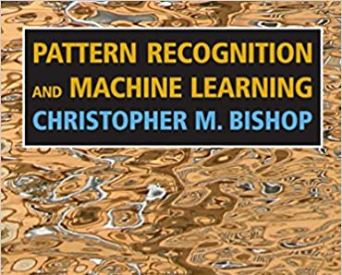
Textbooks
Pattern Recognition and Machine Learning
Author: Christopher Bishop
Publisher: Springer
Year: 2006
ISBN: 978-0-38731-073-2
A digital version (PDF print) is freely available and is perfectly fine for this course: you can download it here.

Slide 19
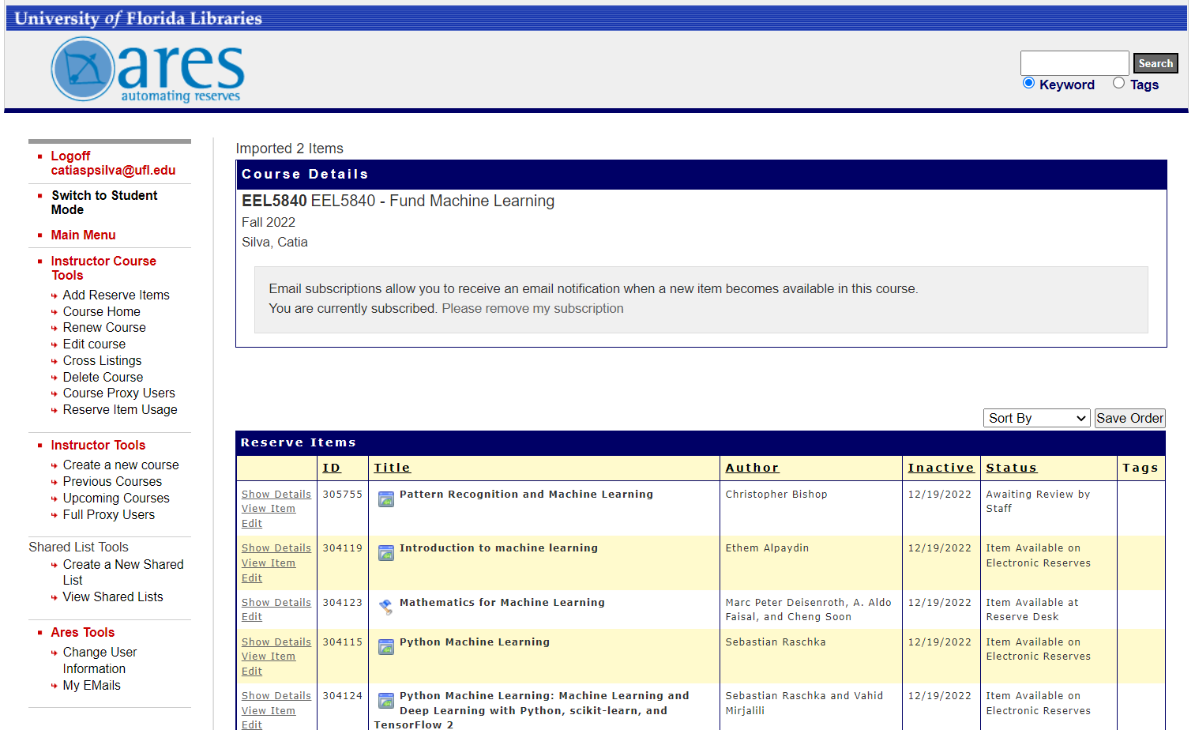
Course Reserves
Additional readings will be listed in Canvas under each module.
All reading materials are available in Course Reserves as electronic texts and hard copy (at the Marston’s library).
Access Course Reserves directly in Canvas.

Slide 20
Course Schedule
Module | Lecture | Day | Topic/s
1. Introduction to Machine Learning | 1 | R, 08/25 | What is Machine Learning? Introduction to Git, Jupyter Notebooks and Python Types of learning Introduction to Supervised Learning with linear regression Model selection; Occam’s Razor
2. Experimental Design and Analysis | 2 | T, 08/30 | Generalization Regularization The Bias-Variance Trade-Off The No Free Lunch Theorem
 | 3 | R, 09/01 | Experimental Design Hyperparameter tuning; Cross-validation The Curse of Dimensionality
3. Bayesian Learning | 4 | T, 09/06 | Maximum Likelihood Estimation (MLE) Maximum A Posteriori (MAP)
 | 5 | R, 09/08 | Bayesian Prior Equivalence
 | 6 | T, 09/13 | HiperGator help session Introduction to Classification Naïve Bayes Classifier
4. Generative Classification | 7 | R, 09/15 | Mixture Models Expectation-Maximization (EM) algorithm Gaussian Mixture Models
 | 8 | T, 09/20 | Evaluation Metrics Final Project Discussion
5. Non-parametric Learning | 9 | R, 09/22 | K-Means Clustering Cluster Validity Metrics K-Nearest Neighbors
6. Discriminative Classification | 10 | T, 09/27 | Linear Discriminant Functions Fisher’s Linear Discriminant Analysis
 | 11 | R, 09/29 | The Perceptron Algorithm Logistic Discrimination
 | 12 | T, 10/04 | Midterm Exam Review
Midterm Exam On-Campus: Monday, October 10 @ 7:20 PM – 9:20 PM, covers modules 1-6 (Lect. # 1-12) Midterm Exam EDGE/Online: Monday, October 10, covers modules 1-6 (Lect. # 1-12)

Slide 21
Course Schedule
Module | Lecture |  | Day | Topic/s
7. Kernel Machine | 13 | R, 10/06 | R, 10/06 | Kernel Machines Constrained Optimization with Lagrange Multipliers
 | 14 | T, 10/11 | T, 10/11 | Kernel Trick Hard-Margin Support Vector Machine (SVM)
 | 15 | R, 10/13 | R, 10/13 | Slack Variables Soft-Margin SVM
8. Dimensionality Reduction | 16 | T, 10/18 | T, 10/18 | Feature Selection
 | 17 | R, 10/20 | R, 10/20 | Principal Component Analysis (PCA) Kernel PCA
 | 18 | T, 10/25 | T, 10/25 | Supervised vs Unsupervised Dimensionality Reduction Applications of PCA and LDA
9. Manifold Learning | 19 | R, 10/27 | R, 10/27 | Multi-Dimensional Scaling (MDS)
 | 20 | T, 11/01 | T, 11/01 | Isometric Feature Mapping (ISOMAP)
 | 21 | R, 11/03 | R, 11/03 | Locally Linear Embedding (LLE)
10. Artificial Neural Networks | 22 | T, 11/08 | T, 11/08 | Brief History of Artificial Neural Networks Multi-Layer Perceptron (MLP) Universal Approximation
 | 23 | R, 11/10 | R, 11/10 | Backpropagation Introduction to Keras with Tensorflow backend (tf.keras)
 | 24 | T, 11/15 | T, 11/15 | Best Practices for Training ANNs
11. Deep Learning | 25 | R, 11/17 | R, 11/17 | Deep Learning Convolutional Neural Networks
 | 26 | T, 11/22 | T, 11/22 | Tensorflow implementations
 | Thanksgiving break (November 23-26)
 | 27 | T, 11/29 |  | Transfer Learning Implementation and Examples
 | 28 | R, 12/01 |  | Final Project Discussion
 | 29 | T, 12/06 |  | Final Exam Review
Final Project: Tuesday, December 6 @ 11:59 PM Final Exam On-Campus: Wednesday, December 14 @ 5:30 PM – 7:30 PM, covers modules 7-11 (Lect. # 13 -23) Final Exam EDGE/Online: Wednesday, December 14 @ 5:30 PM – 7:30 PM, covers modules 7-11 (Lect. #13-23)

Slide 22
Course Policies
Read the syllabus
How to get help: office hours, email, telephone, or Slack.
Attendance: attendance is not required but I will prepare course materials with the expectation that students will attend class synchronously.
Grading: make sure your submissions are carefully completed with clean and well documented code. Make full use of Jupyter features, such as markdown text. Individual assignments will not be curved. Final grades will be curved.
Late Work: we will accept all assignment submissions if solutions have not yet been released, but you will lose the on-time points listed in the rubric. Solutions will typically be released 1 week after the assignment is due.
Make-Up Policy: If you feel that any assignment needs to be re-graded, you must discuss this with me within 1 week of grades being posted. If approved, the entire assignment will be subject to complete evaluation.
Collaboration: healthy collaboration is encouraged. If another student contributes substantially to your understanding of a problem, you should cite this student. You will not be negatively judged for citing another student.
Cheating and Plagiarism: you are expected to submit your own work. If you are suspected of dishonest academic activity, I will invite you to discuss it further in private. Academic dishonesty will likely result in grade reduction, with severity depending on the nature of the dishonest activity. I am obligated to report on academic misconduct with a letter to the department, college and/or university leadership. Repeat offenses will be treated with significantly greater severity.

Slide 23
Grading
Assignment Type | Total | Percentage Final Grade
Exams | 2 | 20% each
Homework | 4 | 15%
Short Assignments | ~6 | 15%
Participation | ~5 | 10%
Final Project | 1 (group project) | 20%
Grading will be based on:
Homeworks will have 2 parts: (1) quiz with analytical exercises, typically solved on paper. (2) practical problems to be implemented in Python.
Exams will be drawn from lectures and readings. Practice exams will be provided.
Short Assignments will typically consist of short problems (with shorter turnaround time) to help consolidate and retain the information learned in class.
Participation will be in the form of discussion boards participation and class participation
Final Project is a group assignment. The objective of this project is to implement an end-to-end Machine Learning/Deep Learning model using a data set collected from students in the class. The outcomes of the final project include working code and a report.

Slide 24
Mark your calendars!
Midterm Exam
On-campus: Monday, October 10 at 7:20 PM – 9:20 PM, in-person
EDGE/Online: Monday, October 10 at your preferred time, Honorlock
Final Project
Everyone: Tuesday, December 6 at 11:59 PM
Final Exam
On-campus: Wednesday, December 14 at 5:30 PM – 7:30 PM, in-person
EDGE/Online: Wednesday, December 14 at your preferred time, Honorlock

Slide 25
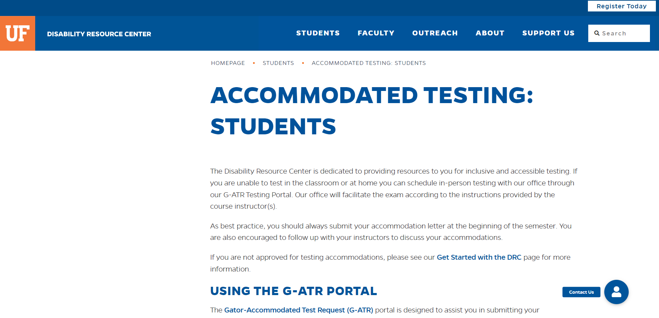
Students requiring accommodations
Students with disabilities who experience learning barriers and would like to request academic accommodations should connect with the DRC (Disability Resource Center) by visiting https://disability.ufl.edu/students/get-started/.
Please make sure you share your accommodation letter with me as soon as you have it, so we can discuss your access needs.

Slide 26
Any questions?

Slide 27
What is (artificial) intelligence?
While several definitions of artificial intelligence (AI) have surfaced over the last few decades, John McCarthy offers the following definition in this 2004 paper
“It is the science and engineering of making intelligent machines, especially intelligent computer programs. It is related to the similar task of using computers to understand human intelligence, but AI does not have to confine itself to methods that are biologically observable.” John McCarthy, 2004
Decades before this definition, the birth of AI conversation was denoted by Alan Turing’s seminal work, “Computing and Intelligence”, published in 1950. Turing inquired: “Can machines think?”.

Slide 28
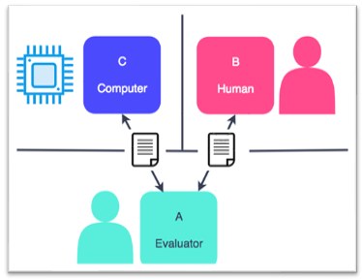
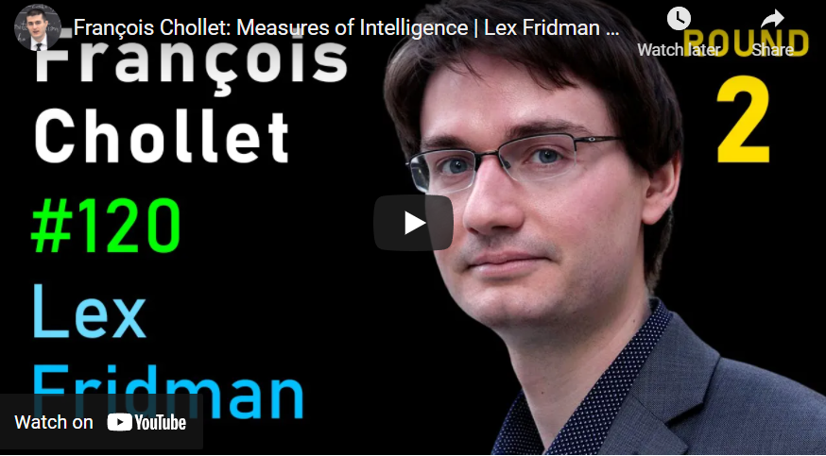
Turing Test – Current Benchmark
Intelligence does not have to depend on relating it to human intelligence.
The ideal approach is:
Systems that think rationally
Systems that act rationally
Alan Turing’s definition falls under the category of systems that act like humans.
Whereas the human approach is:
Systems that think like humans
Systems that act like humans
In 2019, François Chollet proposed a new measure of intelligence proposed a new measure of intelligence based on Algorithmic Information Theory, describing intelligence as skill-acquisition efficiency and highlighting the concepts of scope, generalization difficulty, priors, and experience
Podcast episode “Measures of Intelligence” by Lex Fridman

Slide 29
Types of AI
At its simplest form, AI is a field, which combines computer science and robust datasets, to enable problem-solving. It also encompasses sub-fields of machine learning and deep learning, which are frequently mentioned in conjunction with artificial intelligence. These disciplines are comprised of AI algorithms which seek to create expert systems which make predictions or classifications based on input data.

Slide 30

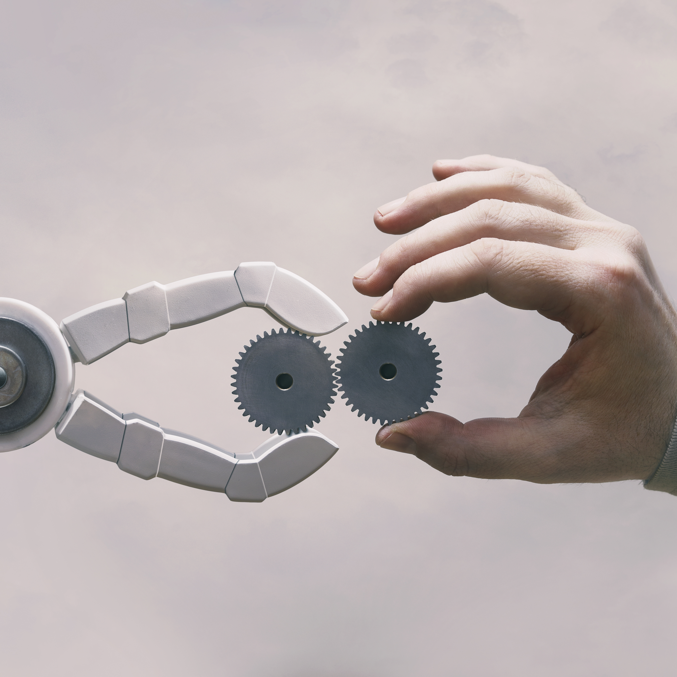
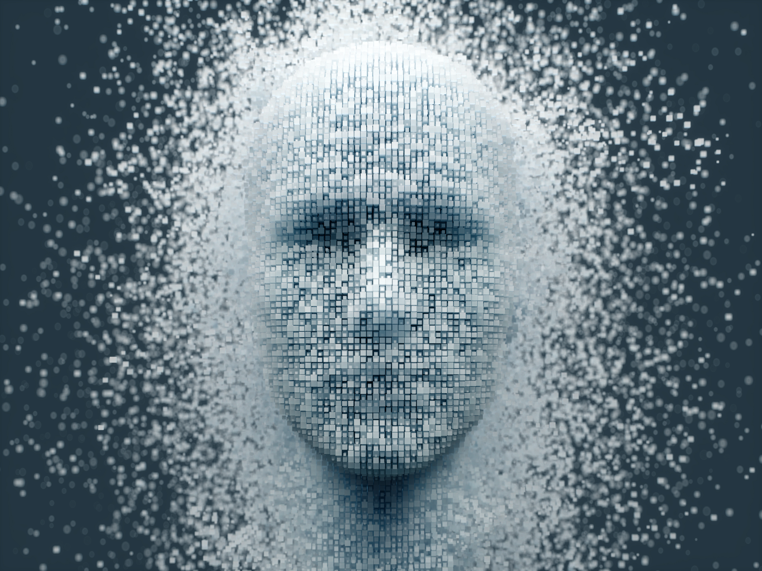
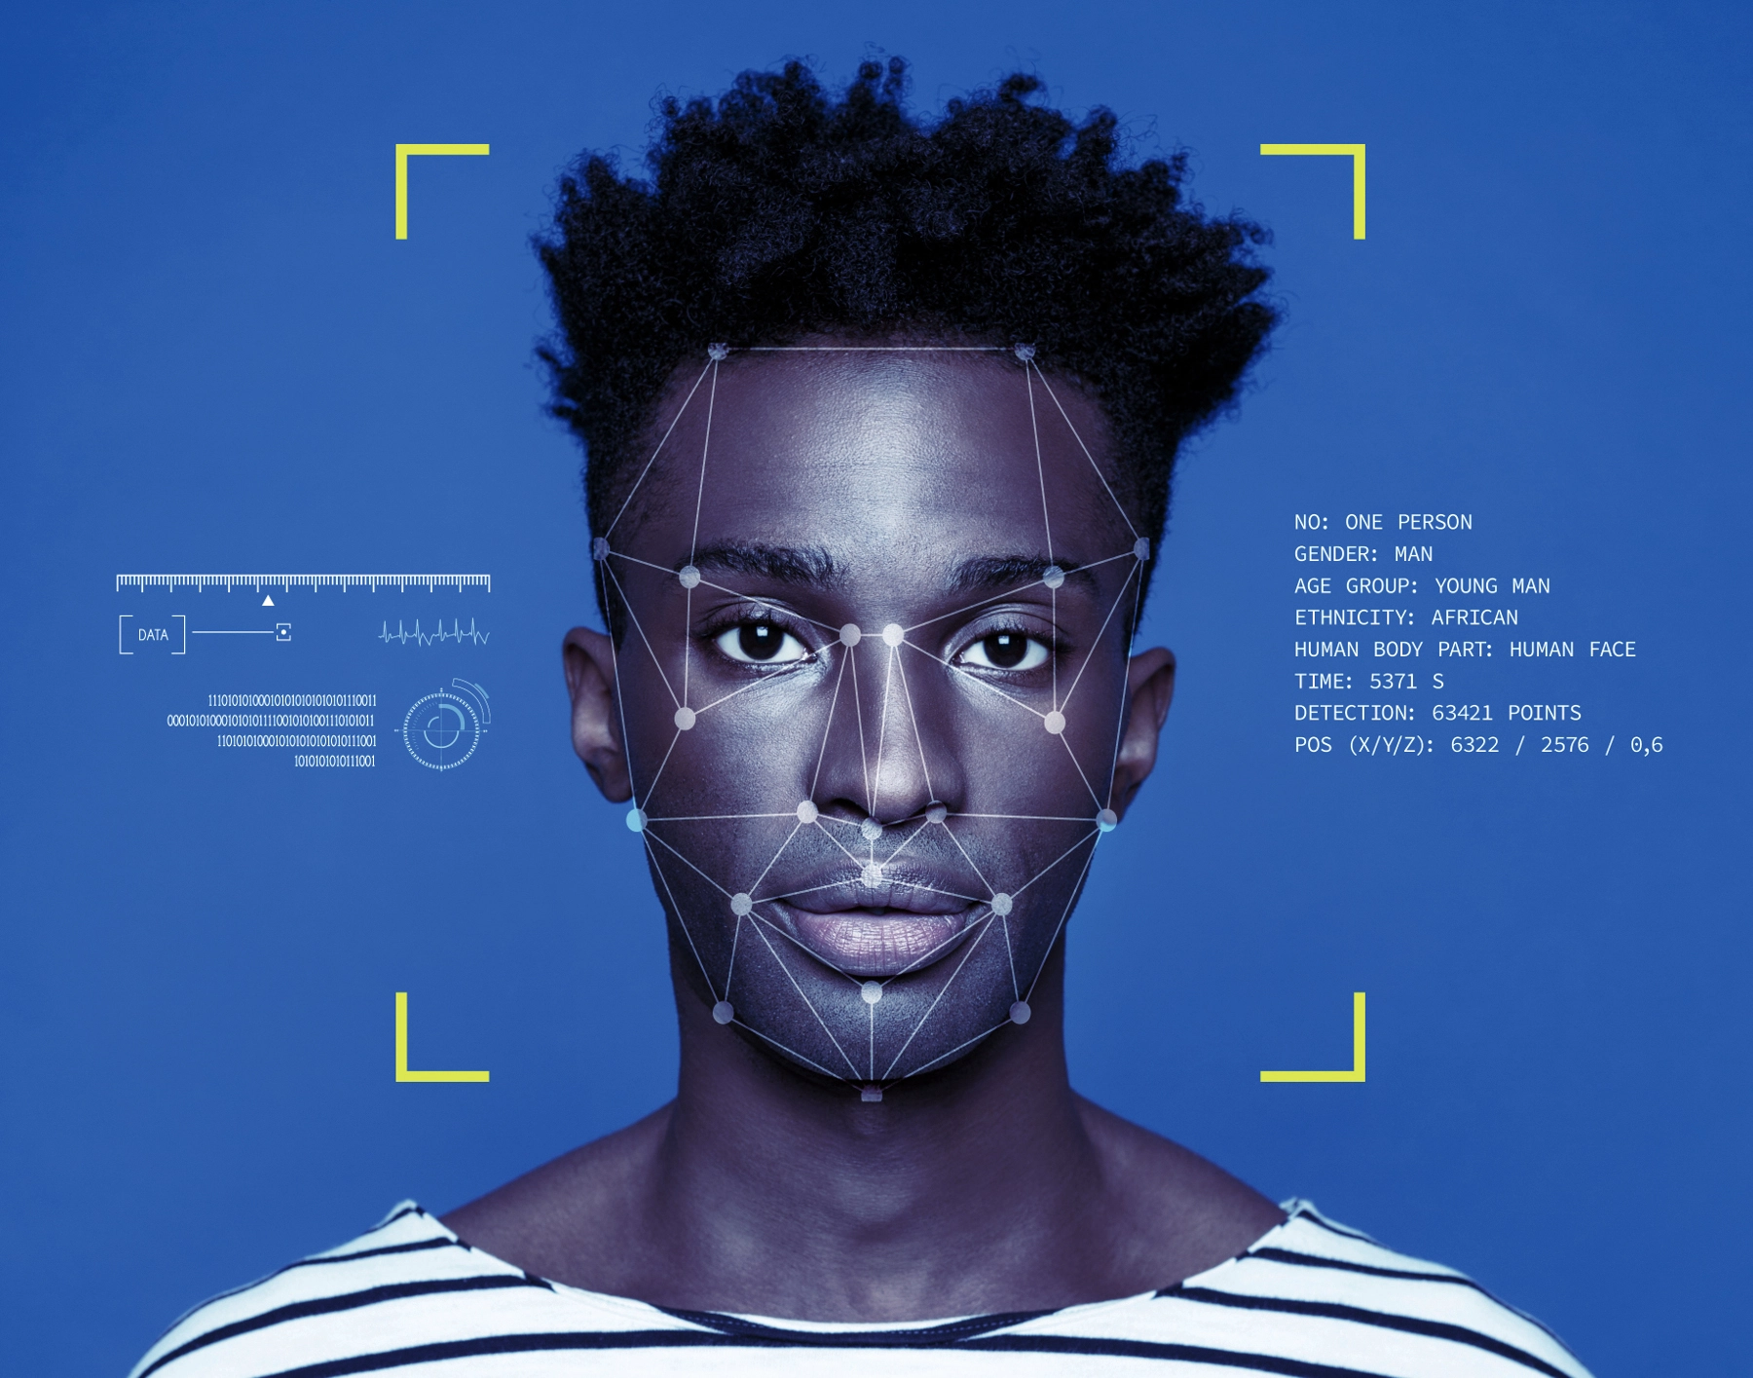

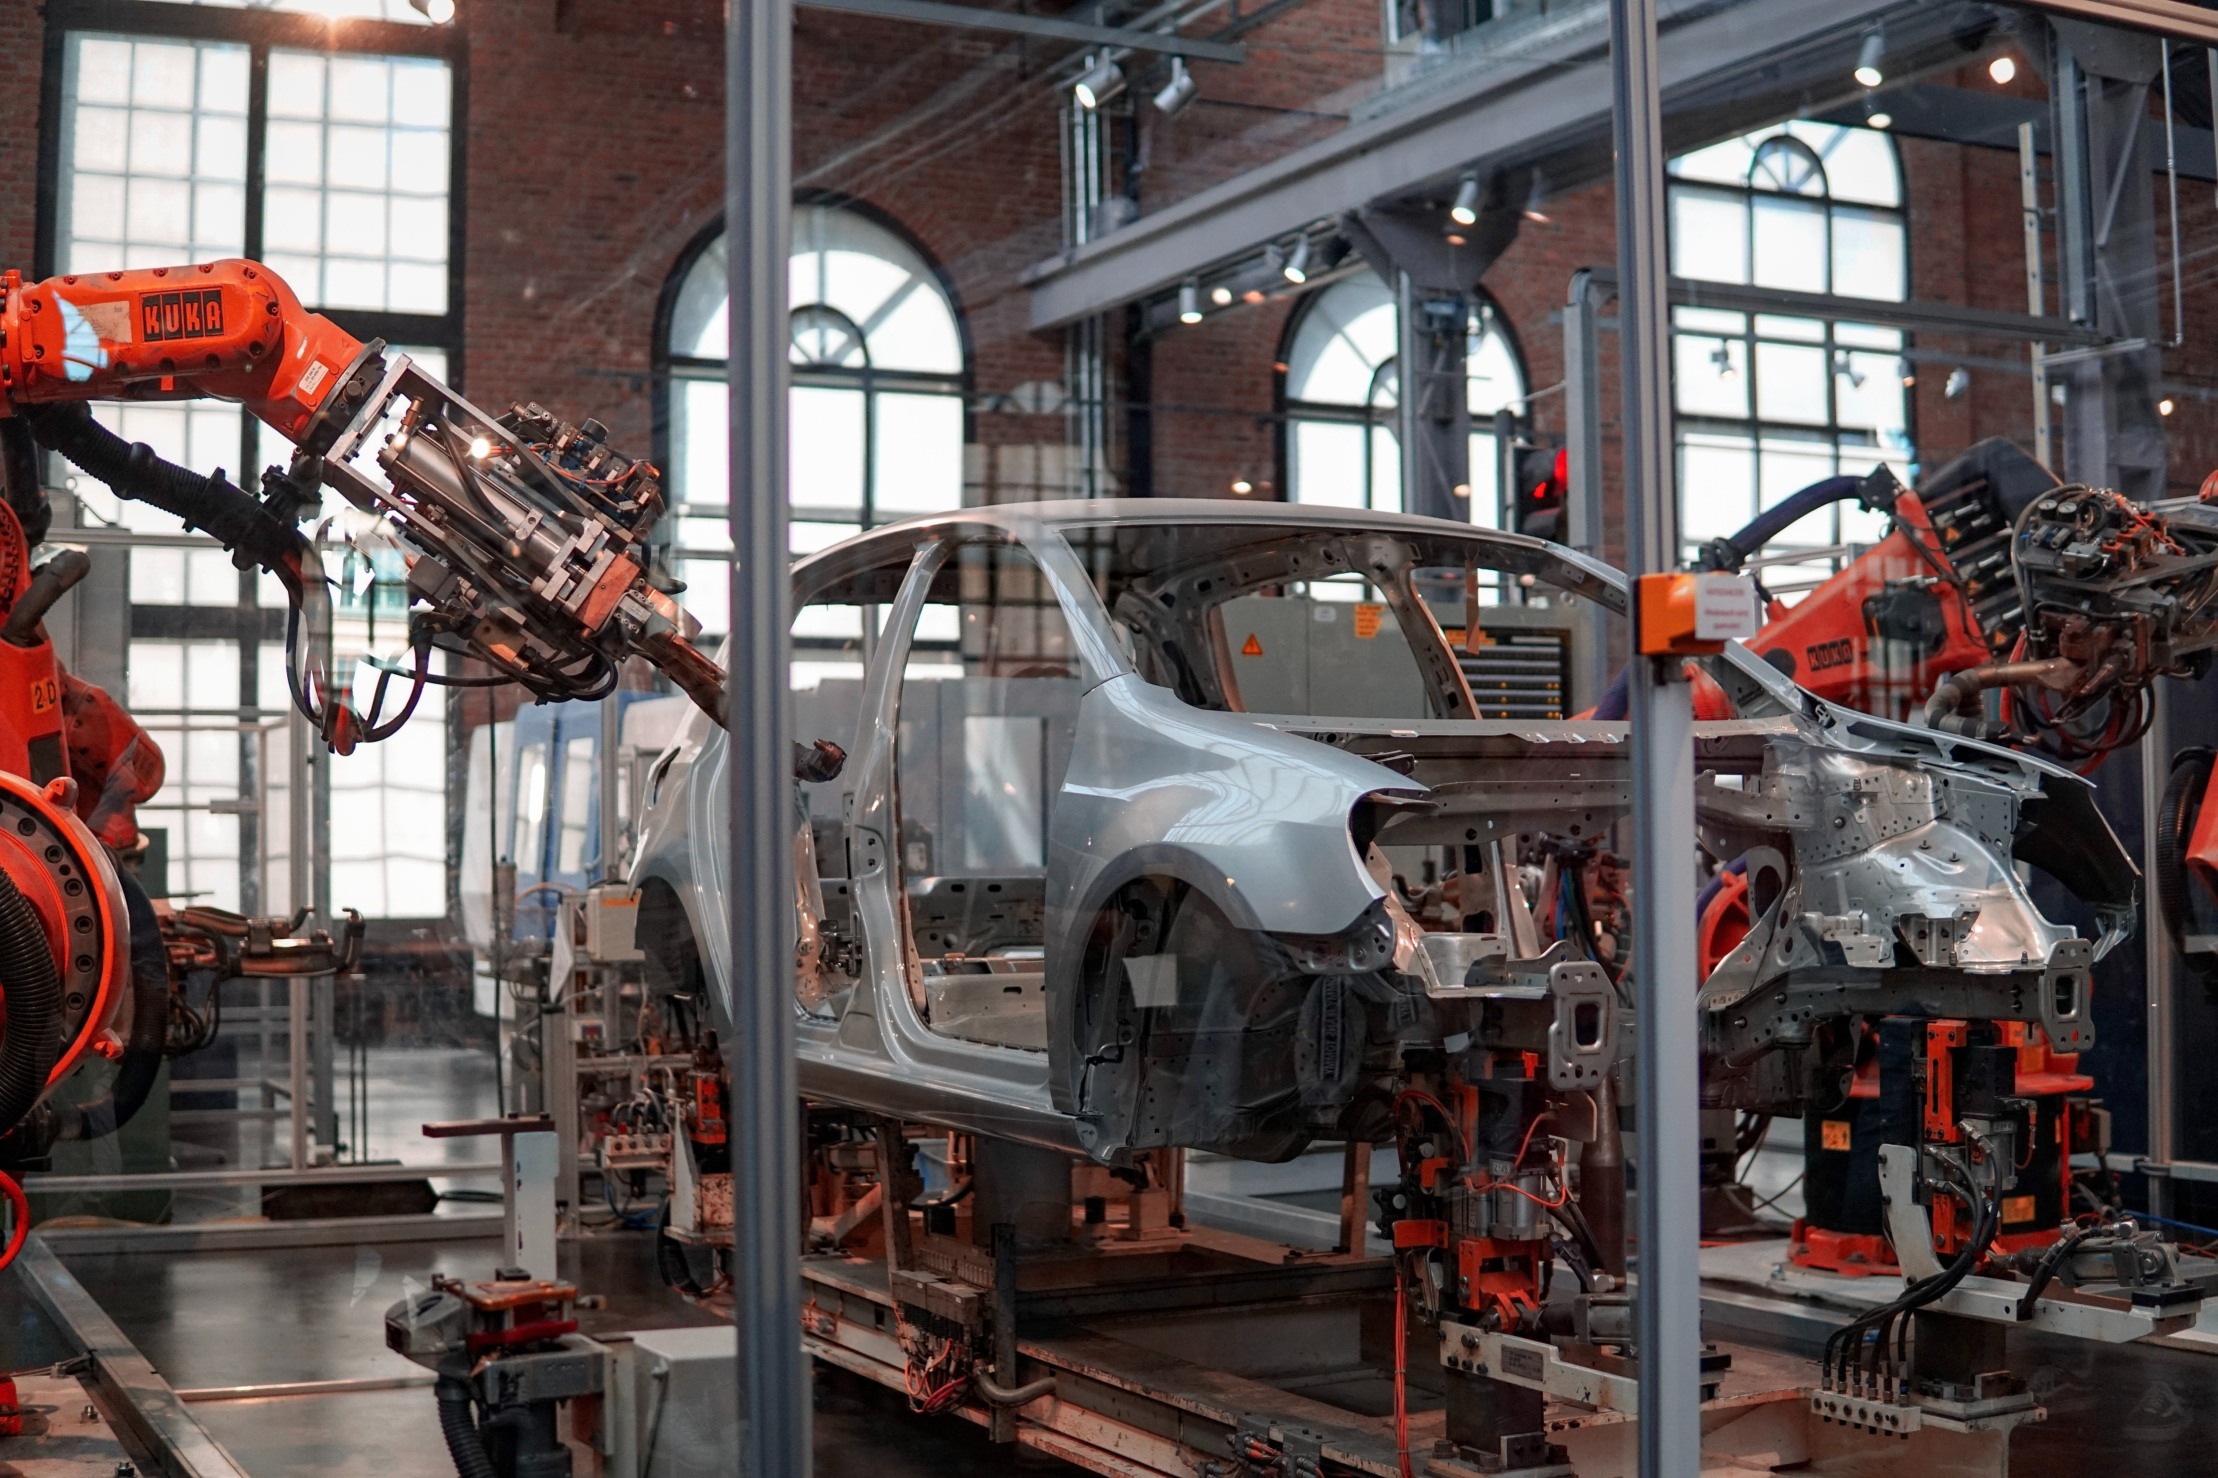
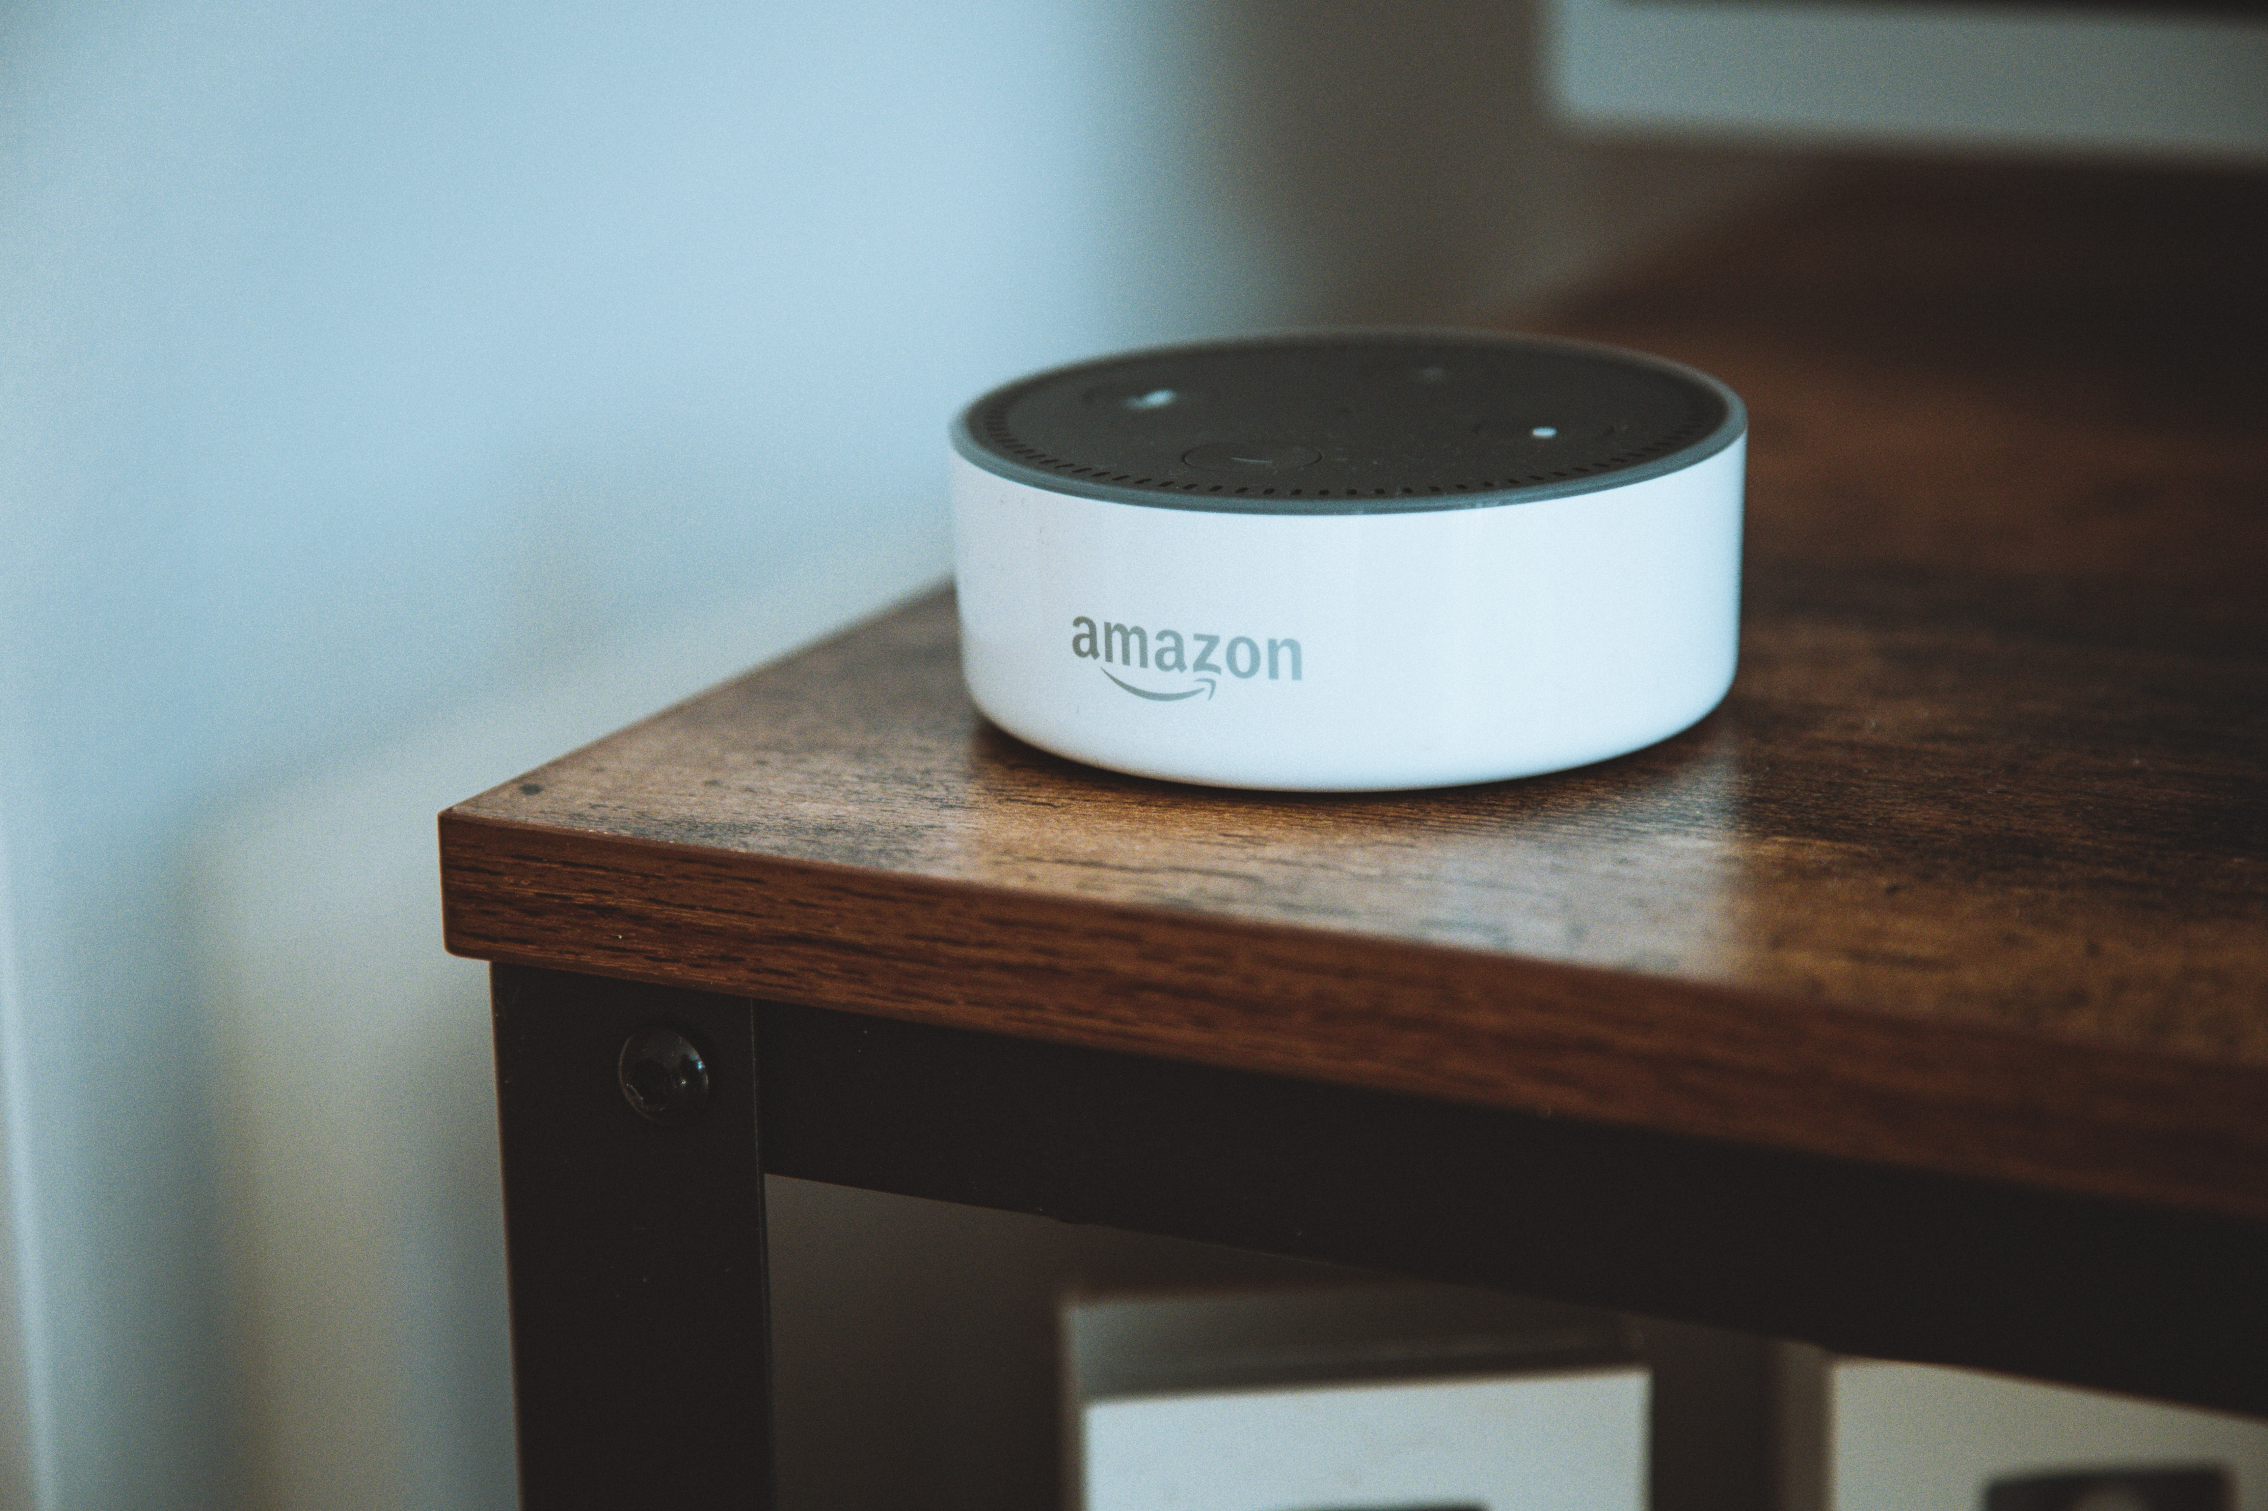
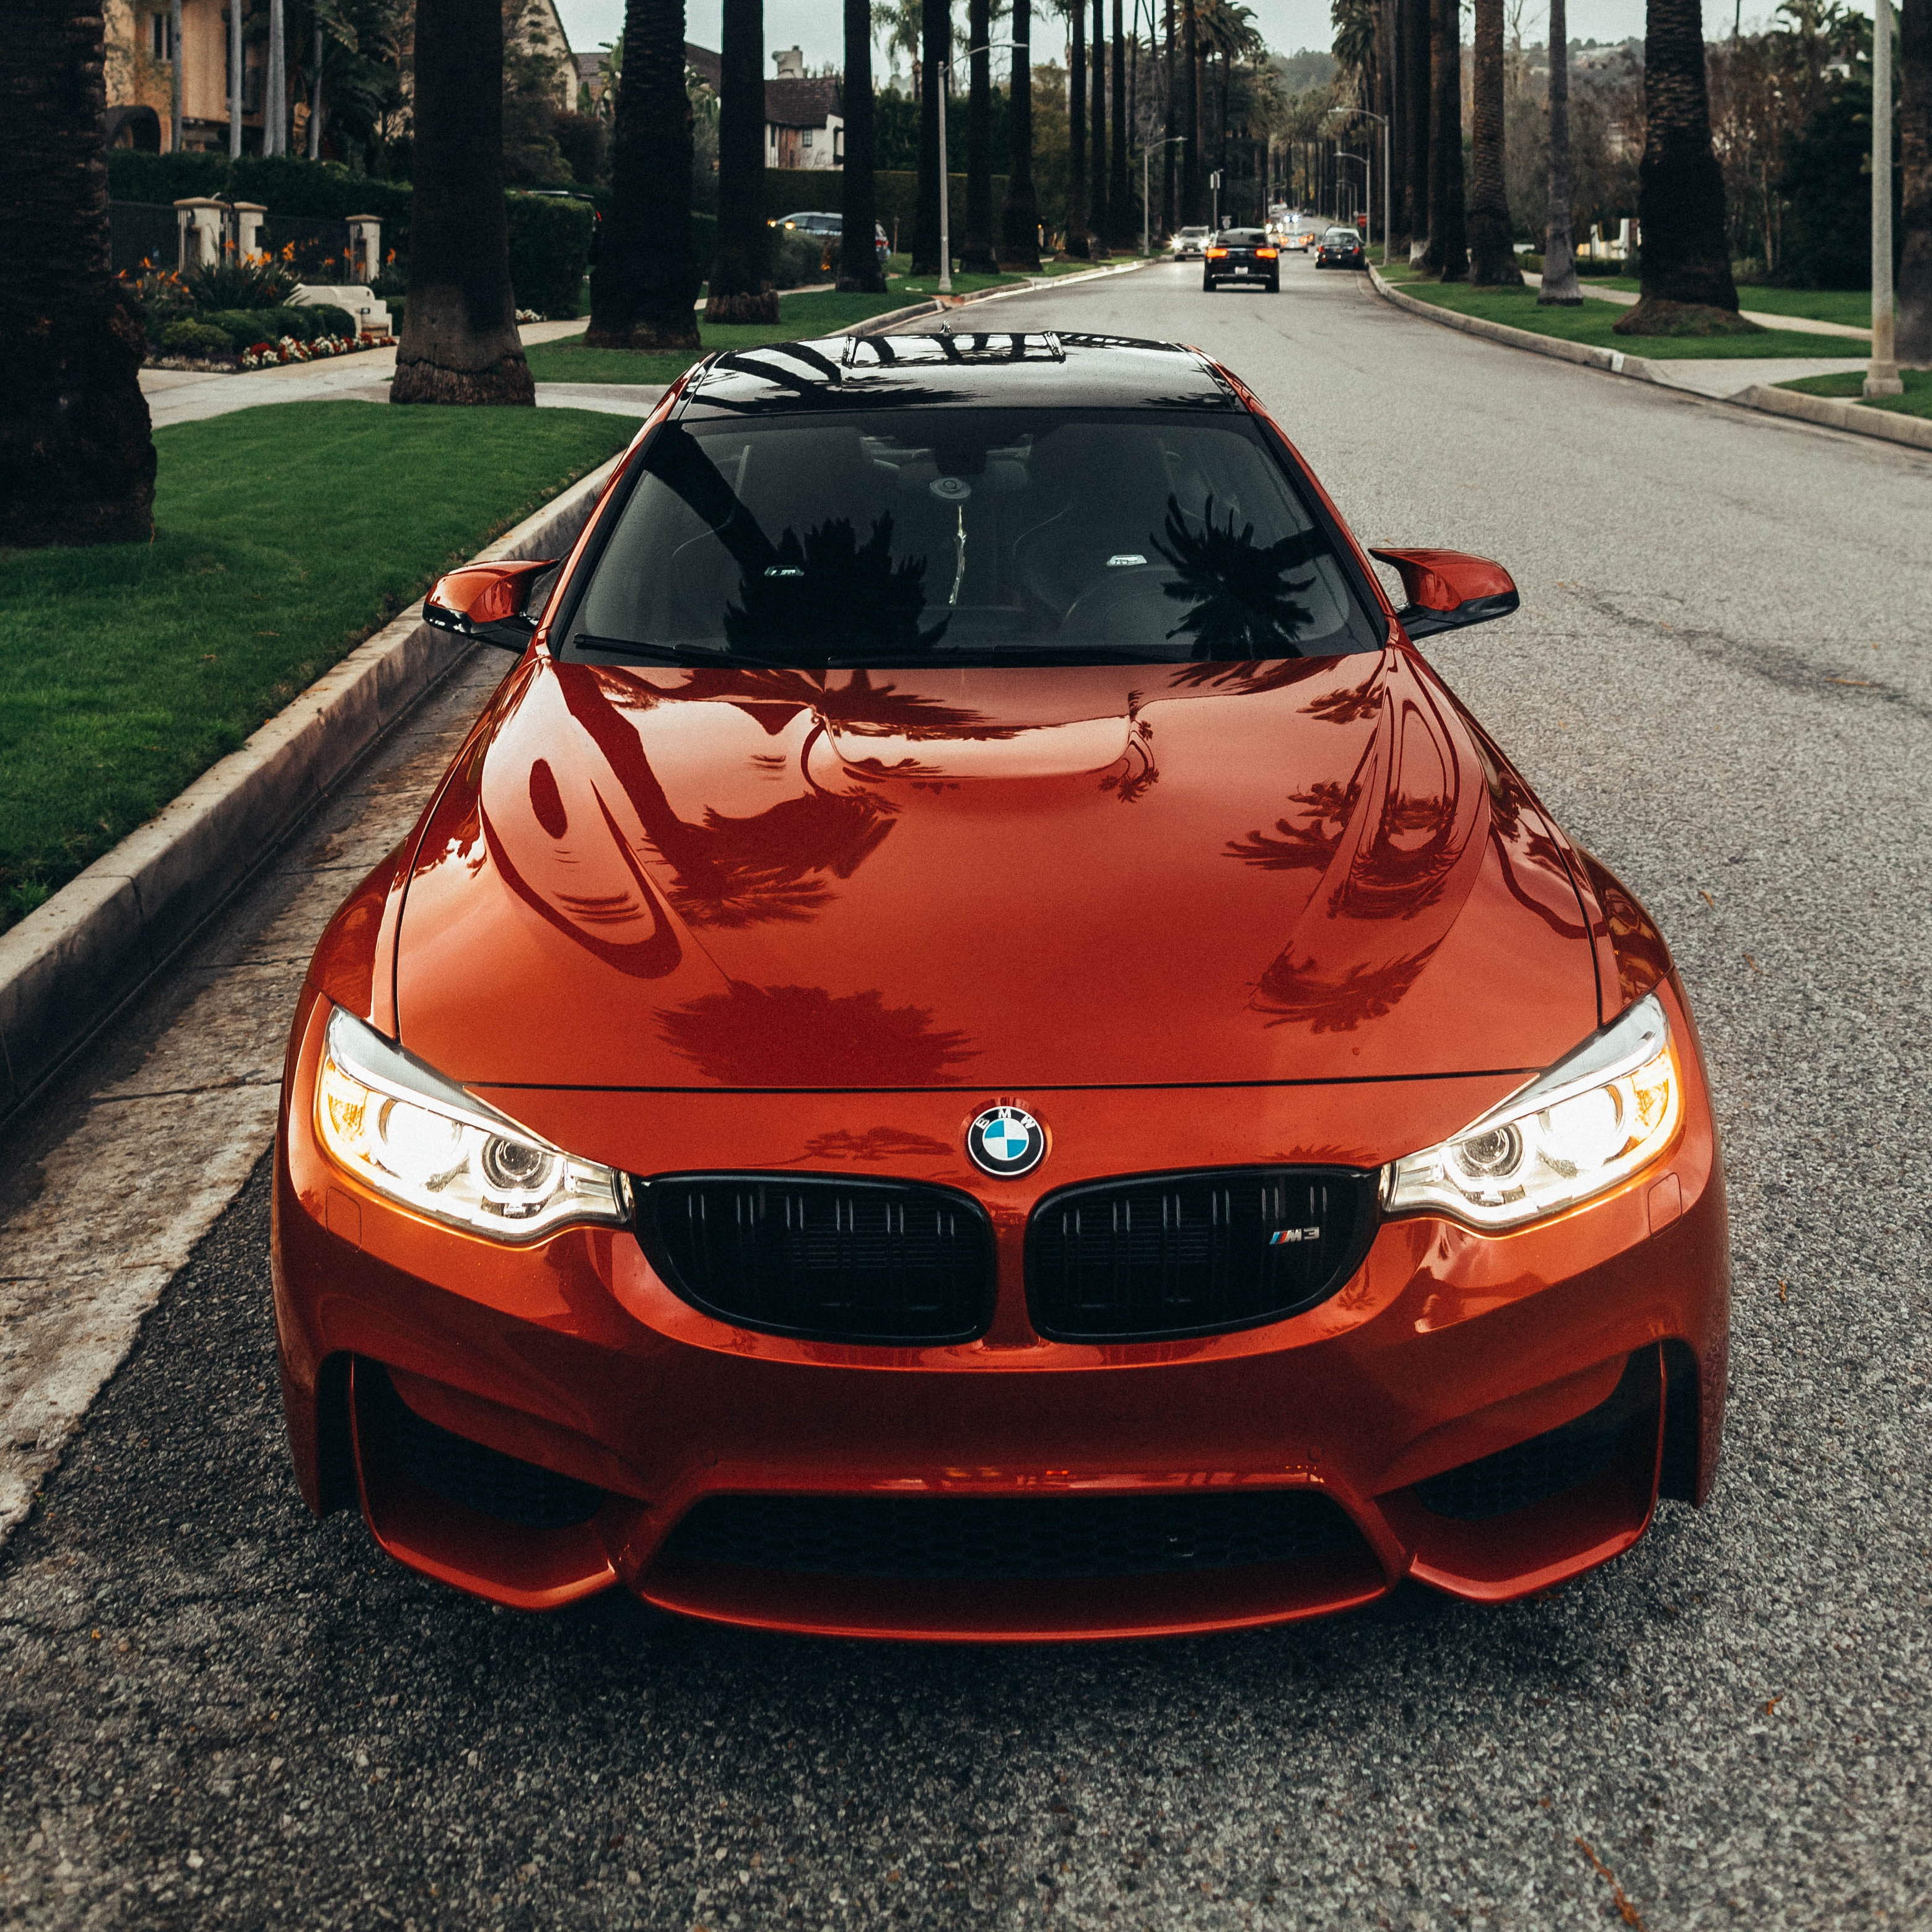

Types of AI
Weak (or Narrow) AI
AI focused on a specific task
Drives most of the AI that surrounds us today
Strong AI
Strong AI
Artificial General Intelligence (AGI)
Artificial Super Intelligence (ASI)
Weak AI
Notes:
Weak AI or Narrow AI is AI trained and focused to perform specific tasks. Narrow AI drives most of the AI that surrounds us today. Examples: Amazon's Alexa, IBM Watson, autonomous vehicles
Strong AI is made up of Artificial General Intelligence (AGI) and Artificial Super Intelligence (ASI). Artificial general intelligence (AGI), or general AI, is a theoretical form of AI where a machine would have an intelligence equaled to humans; it would have a self-aware consciousness that has the ability to solve problems, learn, and plan for the future. Artificial Super Intelligence (ASI)—also known as superintelligence—would surpass the intelligence and ability of the human brain. While strong AI is still entirely theoretical with no practical examples in use today, that doesn't mean AI researchers aren't also exploring its development. In the meantime, the best examples of ASI might be from science fiction, such as HAL, the superhuman, rogue computer assistant in 2001: A Space Odyssey, or the fictional character Dolores in the TV show WestWorld.

Slide 31
What is Machine Learning?
Think-Pair-Share activity
www.wooclap.com/HYIIPP

Slide 32
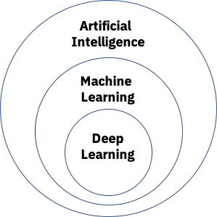
What is Machine Learning?
Machine Learning is a subset of Artificial Intelligence.
Machine Learning can be defined as the machine general ability to solve intelligent tasks by learning from experience/data without being explicitly programmed.

Slide 33
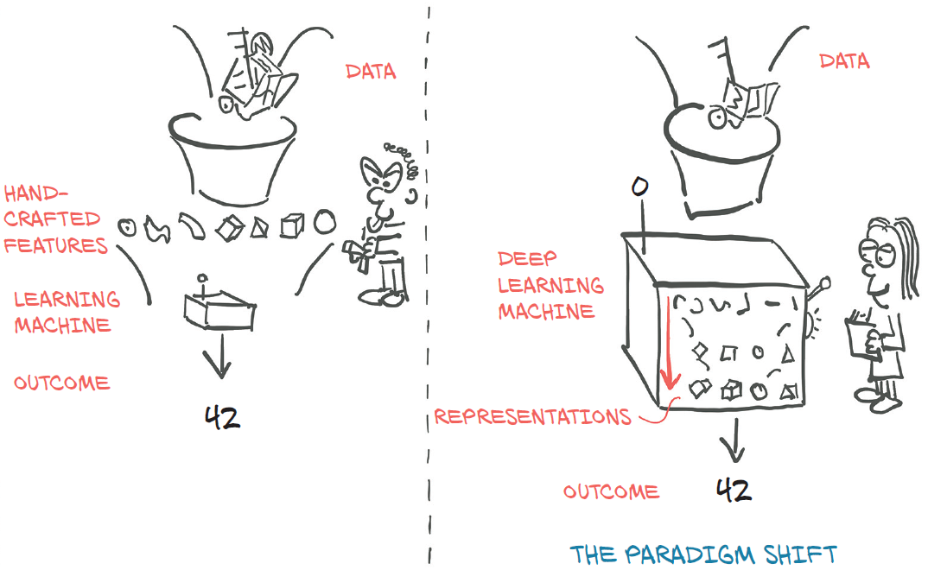
What is Deep Learning?
Deep learning distinguishes itself from classical machine learning by the type of data that it works with and the methods in which it learns.
Deep learning is comprised of neural networks. "Deep" in deep learning refers to a neural network comprised of more than three layers.
Feature engineering consists of producing the right transformations so that the downstream algorithm can solve a task.
Deep learning deals with finding such representations automatically, from raw data, in order to successfully perform a task.

Slide 34


Demonstrations – Git Basics
Install Git. Alternatively, you can install GitHub Desktop.
Create a GitHub account.
How to clone a repository?
You can use Git Bash to clone a repo (alternative: use GitHub Desktop interface).
For example, let's create the "Short Assignment 0” repository and clone it.
Getting the latest edits from a repository with git pull.
To pull from a repository, simply call git pull using Git Bash.
How to manage files within a repo?
The 3 most used Git commands are: git pull, git add, git commit and git push. You can call these commands directly with the Git Bash console or using the GitHub Desktop interface.

Slide 35
Demonstrations – Conda Environment
Install the Anaconda Package (it includes Python 3.9).
If you are installing Anaconda for the first time, this will create a base environment with all the Anaconda libraries installed and ready to run.
Create a new environment and install all packages/libraries.
conda create --name eel5840
conda activate eel5840
conda install anaconda
Customize your environment by installing Jupyter Notebook extensions.
conda install -c conda-forge jupyter_contrib_nbextensions
Launching Jupyter Notebooks
conda activate eel5840
jupyter notebook

Slide 36
Any questions?
Let’s take a break before starting the next period

